Slide 1
The Military
Whistleblower
Protection Act
Title 10, United States Code (USC),
Section 1034
https://www.law.cornell.edu/uscode/text/10/1034
Notes:
SO GETTING RIGHT INTO IT.
I’D LIKE TO OPEN THIS TOPIC WITH HEARING A COUPLE OF YOUR THOUGHTS ON THE WORD “WHISTLEBLOWER”.
WHEN YOU HEAR WHISTLEBLOWER, IN THREE WORDS OR LESS, WHAT DO YOU HEAR? WHAT COMES TO MIND?
YES!! OK, THESE ARE COMMON TERMS WE’VE ALL HEARD BEFORE.
BUT CONTRARY TO NEGATIVE CONNOTATION ASSOCIATED WITH WB, the Military whistleblower protection act that is codified under Title 10 United States Code (USC) section 1034 and ENCOURAGES SERVICE MEMBERS TO COME FOR WITH ALLEGATIONS OF IMPRORIETY, ALLEGATIONS OF WRONGDOING

Slide 2
Overview
Case Study
Categories of Complainants
Terms and Definitions
Elements of Proof (Factors)
Resolving Allegations of Whistleblower Reprisal (IGAP)
Notes:
HERE’S OUR AGENDA.
WE’LL OPEN WITH A REALWORLD ARMY WHISTLEBLOWER CASE STUDY. This will give you a good idea of what Whistle Blower Reprisal is and show you where we were at that time, versus where we are now with the Whistleblower Protection Act.
DISCUSS TYPES OF COMPLAINANTS YOU’LL ENCOUNTER
IN TRUE ARMY FASHION, WE’LL GO OVER COMMON TERMS AND KEY DEFINITIONS
THE FOUR ELEMENTS OF PROOF ASSOCIATED WITH THE ALLEGATIONS OF WBR
AND OF COURSE REMAIN FAITHFUL TO OUR PROCESS, WE’’LL LEARN HOW TO RESOLVE ALLEGATIONS OF WBR USING THE IGAP

Slide 3
Terminal
Learning Objectives
ELOs
Action: Resolve allegations of Whistleblower reprisal using the Inspector General Action Process and Department of Defense guidance.
Conditions: Given Army Regulation 20-1, The Assistance and Investigations Guide, 10 USC 1034, DoD Directive 7050.06, classroom handouts, and classroom instruction.
Standard: Identify the categories of Whistleblower complainants, the agencies responsible to receive Whistleblower complaints and conduct Whistleblower investigations, and the four questions used to establish a case of Whistleblower reprisal.

Slide 4
Enabling
Learning Objectives
ELOs
Describe the four categories of Whistleblower complainants.
Describe the agency authorized to receive Whistleblower allegations.
Identify what agency is responsible for investigating reprisal allegations for each complainant category.
Describe the four questions (or factors) that establish the framework for an investigation into an allegation of Whistleblower Reprisal (WBR).

Slide 5
Safety and Environmental
Safety Requirements: No other specific safety requirements are unique to this block of instruction per DA PAM 385-30, Risk Management, dated 2 December 2014.
Risk Assessment Level: Low in accordance with TRADOC Regulation 385-2, U.S. Army Training and Doctrine Command Safety and Occupational Health Program, dated 9 January 2019.
Environmental Considerations: None in accordance with AR 200-1, Environmental Protection and Enhancement, dated 13 December 2007, and ATP 3-34.5, Environmental Considerations, dated January 2024.

Slide 6
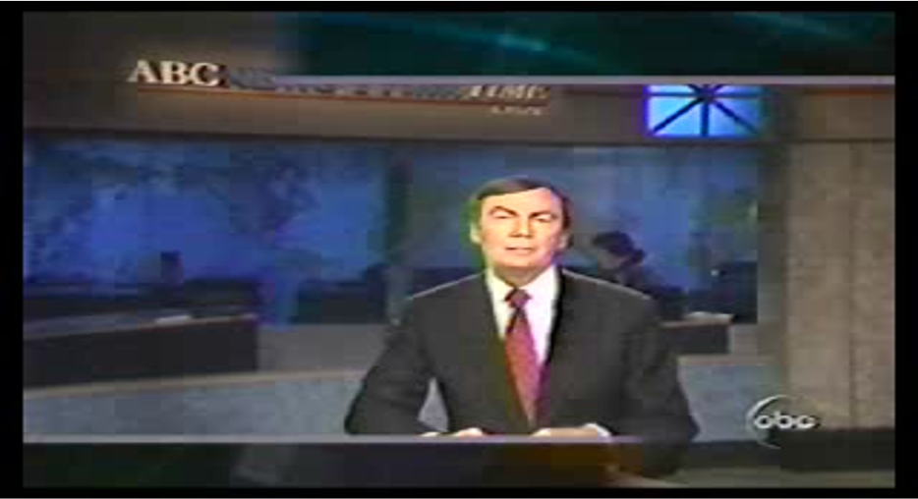
The Case Study

Slide 7

The Case Study
The purpose and intent of the Military Whistleblower Protection Act is to enhance good order and readiness by encouraging Soldiers to come forward in good faith with complaints of wrongdoing and other issues (protected communications).

Slide 8





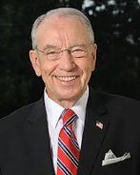




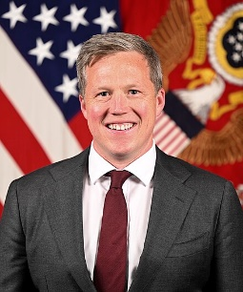

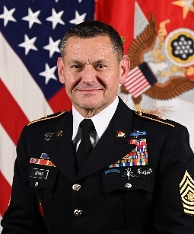
Military Whistleblower Reprisal
Media interest
Congressional Interest
Special Interest Groups
Current Situation…
Remedy Wrongs - ARBA
Senior Leader Decisions
Army Board for Correction of Military Records (ABCMR)
Army Discharge Review Board (ADRB)
Army Grade Determination Review Board (AGDRB)
Our task … get it right, for the right reasons
Notes:
As of August 4, 2023, Michael R. Weimer is the 17th Sergeant Major of the United States Army

Slide 9
Military Whistleblower Reprisal
Standards / References
Military: Title 10 USC 1034 and DoD Directive 7050.06
        DoD Instruction 7050.09
NAF: Title 10 USC 1587 and DoD Directive 1401.03
AF: Title 5 USC 2302(b)(8);
        Presidential Policy Directive-19 (PPD-19)
Contractor Employees: 10 USC 2409; Defense Federal Acquisition Regulation (DFAR), Subpart 203.9
FY14 / FY17 NDAA: 10 USC 1034, DoDD 7050.06, 10 USC 2409 (Influenced changes to DoDD 7050.06)
AR 20-1, paragraphs 1-13, 7-3b
AR 600-20, paragraphs 5-11 and 5-12
A&I Guide, Part Two, Chapter 9
MCM 2024, Article 132 (Does not serve as WBR standard)

Slide 10
Military Whistleblower Reprisal
References
DoD OIG Whistleblower Protection Coordinator (WPC)
Point of Contact: Mr. Kenneth M. Sharpless Website: WhistleblowerProtectionCoordinator@dodig.mil or
WWW.DoDIG.Mil
Email: wpc@dodig.mil
Office: (703) 699-1794
Educates all DoD employees on:
  Reporting fraud, waste, and abuse without fear of reprisal.
  Roles the Office of Inspector General, the Office of Special Counsel, the Merit Systems Protection Board, and others
  Case timeline requirements and information
  Alternative dispute resolution or relief options
Promotes timely handling and consideration of allegations
Facilitates communication and coordination with stakeholders.

Slide 11
What does Whistleblower Reprisal mean to the IG?
Only IGs can investigate allegations of military WBR when presented to an IG.
An IG cannot refer an allegation of reprisal
Only DoD IG (Office of Oversight) can evaluate and close a WBR investigation
DoD IG’s ROI completion goal is 180 days
Office of Inquiry requirement is 150 days

Slide 12
Military Whistleblower Protection
  DoDD 7050.06, dated 12 October 2021
  10 USC 1034, Armed Forces members shall be free to make a Protected Communication (PC)
  Soldiers have the right to raise matters of fraud, waste, abuse, or other improprieties within the Army without fear of reprisal
  No person shall restrict a member of the Armed Forces from making lawful communications to a Member of Congress (or their staff) or to an IG
  Defines chain of command to include the supervisory and rating chain

Slide 13
Military Whistleblower Protection
  DoDD 7050.06, dated 12 October 2021
  DoD IG shall investigate or oversee DoD Component IG investigations of allegations (Office of Oversight)
  No investigation is “required” when a member submits a complaint more than 1 YEAR* after becoming aware of the personnel action
    This complaint is considered “Untimely”.
  *Change made by FY14 NDAA

Slide 14
IG Records for Adverse Action
Per DODD 7050.06, 12 October 2021, paragraph 6(d)(2), directs SECARMY to take appropriate corrective or disciplinary action against the individual who committed the reprisal or restriction
Per AR 20-1, paragraph 3-5a, IG records (ROI) may be used as the basis for adverse action against individuals, military or civilian, by directing authorities or commanders if they contain a substantiated allegation of Whistleblower Reprisal (Also noted in the A&I Guide, Part II Section 9-1, II - 9 – 4)
National Guard falls under State Code of Military Justice - Adverse action taken in one status likely affects other statuses.

Slide 15
Categories of WBR Complainants
ELO
1
Military Member
Appropriated Fund (AF) Civilian
Non-Appropriated Fund (NAF) Civilian
Contractor Employee
Active Component (AC), USAR (RC), and National Guard (NG) (Federal interest)
General Schedule (GS) / Wage Grade (WG)
AAFES / MWR Employees
Kellogg Brown & Root (KBR), CACI,
Booz Allen Hamilton (BAH), etc.
Notes:
Pay attention as this is ELO number 1 and there are four categories of Whistleblower reprisal complainants.
We have military members, non-appropriated fund civilians, appropriated fund civilians and contractor employees.
Now let’s talk who these folks are? Military members include who? Active Duty, Reserve component and National guard. But it also includes all the other services as well and their component. Military is joint in that regard.
You also have Non-appropriated fund civilians. Who does that include? Such as AAFES/ MWR employees.
Then we have appropriated fund civilian. These are your wage grade employees.
And last you have contractor employees
All of these people could potentially be in a position where they witness some sort of wrongdoing and may need to make a complaint but may also need protection from some form of retaliation or reprisal based off that reporting.
That being said not all of them are going to process in your Army IG office.

Slide 16
Agency Authorized to Receive WBR Allegations
ELO
2
Military Member
Appropriated Fund Civilian
Non-Appropriated Fund (NAF) Civilian
Contractor Employee
Any Service IG can receive – DoD IG oversight
Refer complainant to: Office of Special Counsel
Refer complainant to: DoD IG
Refer complainant to: DoD IG
Notes:
There are agencies that will take WBR complaints depending on the category the complainant belongs to. Non-appropriated fund civilian and contractor employee are in red because you will refer their complaints to DOD IG.
Appropriated fund civilians refer their complaints to the office of special counsel.
But a military member can file a complaint of reprisal to any DOD IG office meaning any service IG. So for an example an Air Force member can walk into an Army IG office file a whistle blower reprisal to which you as an Army IG are required to process it . Why are you required to process an Air Force complaint of reprisal? Because they fall underneath the DOD umbrella as far as a military member.
Again remember it’s the military whistleblower protection act, not the Army whistleblower protection act. So any military member will follow the exact same process and it all filter its way to DOD IG who will then assign the WBR complaint to the appropriate service based off who the complainant is in that case.
But everybody else, non-appropriated fund civilian, appropriated fund civilian and contract employees, if they are the complainant, we are not going to receive their complaint as an Army IG office, we are going to refer them to the appropriate agency as it pertains to them.
Again this is ELO number 2.

Slide 17

Agency Responsible for Investigating WBR
(1 of 4)
ELO
3
Military WBR Complaints:
Service IGs will investigate military complaints (allegations) of Whistleblower Reprisal
DoD IG has oversight of Title 10
reprisal investigations
DoD IG has oversight of Title 32 (NG)
not on State Active Duty orders
Military members have the right to
appeal investigation through the ABCMR
The final appellate authority is the Under Secretary of Defense Personnel & Readiness

Slide 18

Agency Responsible for Investigating WBR
(2 of 4)
ELO
3
Appropriated Fund Civilian WBR Complaints
Office of Special Counsel (OSC)
www.osc.gov
U.S. Office of Special Counsel
1730 M Street, N.W., Suite 218
Washington, D.C. 20036-4505
Tel: (800) 572-2249 or (202) 804-7000

Slide 19
Agency Responsible for Investigating WBR
(3 of 4)
ELO
3
Non-Appropriated Funds (NAF) WBR complaints
DoD Inspector General (IG)
Website: www.dodig.mil
Email: wpc@dodig.mil
U.S. Department of Defense
Office of the Inspector General
4800 Mark Center Drive
Alexandria, VA 22350-1500
Tel: (703) 604-8324

Slide 20
Agency Responsible for Investigating WBR
(4 of 4)
ELO
3
DoD Contractor WBR complaints
DoD Inspector General (IG)
Website: www.dodig.mil
Email: wpc@dodig.mil
U.S. Department of Defense
Office of the Inspector General
4800 Mark Center Drive
Alexandria, VA 22350-1500
Tel: (703) 604-8324

Slide 21
ELO Check on Learning
ELO 1. Describe the four categories of Whistleblower complainants.
ELO 2. Describe the agency authorized to receive Whistleblower allegations.
ELO 3. Identify what agency is responsible for investigating reprisal allegations for each complainant category.
- Agency that has oversight of military WBR?

Slide 22
Whistleblower Terms
PC: Protected Communication
PA: Personnel Action
RMO: Responsible Management Official
WBR: Whistleblower Reprisal
MOC (or MC): Member of Congress
Restriction: Preventing or attempting to prevent military members from making or preparing to make lawful communications to a MOC and / or an IG
Whistleblower Division: 703-545-1858, usarmy.pentagon.hqda-otig.mbx.saig-whistleblower-intake
OOO: Office of Oversight (Department of Defense IG Office)
OOR: Office of Record (Department of the Army IG Office)
OOI: Office of Inquiry (The IG office serving on behalf of the OOO)

Slide 23
Is It Reprisal or Retaliation?
Reprisal is a form of retaliation; BUT not all retaliation is reprisal
Reprisal is statutory and is related to 10 USC 1034. IGs must investigate military reprisal cases when presented to them
Commanders should investigate other forms of retaliation (ostracism and acts of cruelty, oppression, or maltreatment)
Other forms of retaliation:
  AR 600-20, Paragraphs 5-12 and 5-13, and Appendix H
  AR 600-100, Paragraph 1-11
MCM 2024, Article 132 (Retaliation) is a Commander’s tool

Slide 24
What is Whistleblower Reprisal (WBR)?
The taking of (or threatening to take) an
Unfavorable Personnel Action (PA)
- Or -
the withholding (or threatening to withhold) a Favorable Personnel Action (PA)
BECAUSE
the member made (or was thought to have made)
a Protected Communication (PC)

Slide 25


Question One:
“Was there a PC?”
ELO
4
Lawful (truthful) communication to:
First Category
Members of Congress
(to include Congressional staff members)
Inspectors General
Regardless of subject!
(Restriction is also prohibited)
Second Category
DoD audit, inspection, investigation, or law enforcement organization
Any person or organization in the chain of command
Designated personnel pursuant to regulations or established administrative procedures to receive such communications (e.g. EO, Safety Office, etc.)
A court-martial proceeding
AR 20-1, paragraph 1-14b(2); The A&I Guide, Part Two, Section 9-2 (II - 9 - 8)
U.S. Army Inspector General School 25

Slide 26
Question One:
“Was there a PC?”
ELO
4
Did the complainant make or prepare a communication protected by statute?
Was the complainant perceived as having made or prepared a PC?
No actual communication is necessary PERCEPTION = REALITY
If there is any doubt whether the complainant made a Protected Communication (PC) -- give the complainant the benefit of the doubt

Slide 27
Protected Communication (PC)
Protected communication concerns:
Violations of law or regulation
(includes EO, sexual misconduct & assault)
Gross mismanagement
Abuse of authority
Gross waste of funds or resources
Substantial danger to public health or safety
Testimony or participation in an investigation
Reasonably believed to be true by the complainant!
The A&I Guide, Part Two, Section 9-2; 10 USC 1034; DoDD 7050.06

Slide 28
Question Two:
“What was the PA?”
ELO
4
Any action taken on a Service member that affects, or has the potential to affect, that member’s military pay, benefits, or career.
Actions can be unfavorable or favorable (produces a negative effect)

Slide 29
Question Two:
“What was the PA?”
ELO
4
Was an unfavorable Personnel Action (PA):
Taken or threatened against the complainant
Withheld or threatened to be withheld from the complainant
Following the Protected Communication (PC)?
If there is any doubt whether the complainant received an unfavorable Personnel Action (PA) -- give the complainant the benefit of the doubt

Slide 30
Unfavorable Personnel Actions
(Taken or Threaten – not definitive list)
Permanent letters of reprimand
Unfavorable, non-competitive, adverse, or referred evaluation reports
Relief for cause
Transfer or changes to duties or responsibilities
Reenlistment / Separation proceedings
Decisions concerning pay or benefits
Disciplinary or other corrective actions
Referrals for Mental Health Evaluation (MHE)
Limited access to weapons/classified/flying etc.

Slide 31
Favorable Personnel Actions
(Withheld or Threaten – not definitive list)
Evaluations
Promotion Recommendation
Award
Training (required)
Assignment/Nominations
Attendance at school
  (PME; MOS-required training)
Transfer

Slide 32
Question Three:
“Is there RMO Knowledge?”
ELO
4
Did the Responsible Management Official(s) (RMO) who took, withheld, or threatened the unfavorable personnel action know about the PC?
or
Perceive the complainant as having made or
prepared to a make PC?
Before executing the Personnel Action?
‘Timing is Everything'
T I M E L I N E

Slide 33
Responsible Management Official Knowledge
Knowledge includes:
Personally received the Protected Communication (PC)
Heard rumors about the Protected Communication (PC)
Suspicion or belief that the complainant may have made a Protected Communication (PC)
Important to understand:
Precise knowledge of the Protected Communication (PC) is unnecessary
Simple awareness that a (PC) occurred (regardless of subject or content) is sufficient

Slide 34
Question Three:
“Is there RMO Knowledge?”
Anyone who:
RMO = Suspect
Recommended the Personnel Action (PA) be taken
Made the decision to take the PA
Signed applicable correspondence regarding the PA
Approved, reviewed, or endorsed the PA
* RMO can be a Service Member, GS Employee, or NAF Employee

Slide 35
Question Four:
“Is there Inference of Causation?”
ELO
4
Would the same Personnel Action(s) have been taken, withheld, or threatened absent the Protected Communication (PC)?
YES or NO
Does the evidence support that the same Personnel Action(s) would have been taken, withheld, or threatened absent the Protected Communication (PC)?
YES or NO
(Most cases will be resolved here)
The A&I Guide, Part Two, Section 9-3
Notes:
DoD phrase used to describe a probable cause-and-effect relationship
In WBR – used to indicate that the likely reason for the PA is because the complainant made a PC

Slide 36
Inference of Causation
The four variables for Question 4!
For each PA, consider:
  Reason for action
  Timing between PC and PA
  Motive to reprise
  Disparate treatment of complainant as compared to others
  (also known as the 'four variables')
Would the average
RMO (Army Officer, NCO or DAC)
consider the action
reasonable?
The A&I Guide, Part Two, Section 9-3

Slide 37
Let’s Review
(Timing)
Is it reprisal?
does not meet
the elements
of proof
Personnel
Action
Knowledge
of PC
Protected
Communication
Time
maybe?
why?
Protected
Communication
Knowledge
of PC
Personnel
Action
Time
Knowledge
of PC
does not meet
the elements
of proof
Protected
Communication
Personnel
Action
Time

Slide 38
Restriction
Attempting to prevent a Service Member from making a lawful communication to either a MOC or an IG (only applies to a Category I PC)
Includes imposing unnecessary requirements to request, disclose, or report the PC in an effort to interfere, limit, block, or dissuade (complainant’s perspective)
Restriction complaints to Category II recipients are not covered or investigated under 10 USC 1034 or DoDD 7050.06
Does not have to be successful

Slide 39
ELO Check on Learning
ELO 4. Describe the four questions (or factors) that establish the framework for an investigation into an allegation of Whistleblower Reprisal (WBR).
  Difference between retaliation and reprisal?
  What is restriction?
  What are the four elements of proof for a reprisal allegation?
  What are the four variables considered within the element of Causation?

Slide 40

STEP 1: Receive the IGAR
The A&I Guide, Interim Doctrinal Change to Section 9-5
Four Required Documents to Whistleblower Division within ten business days:
    DA 1559 – IG Action Request (IGAR) with supporting documentation
    Complaint Clarification Interview (CCI) (Informal or Formal)
      Status/Identify the Elements/Special Case Screening
      Include a timeline / chronology
    Military Whistleblower Reprisal Intake Worksheet (RIW)
    Military Reprisal / Restriction Complaint Notification (MR / RCN)
Note: DO NOT notify the RMO(s) or their Commander / Supervisor

Slide 41
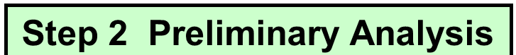
STEP 2: Preliminary Analysis
Select a Course of Action (COA)
Upon Completion of the RIW, as the reporting IG, you are required to complete an MRCD within 30 working days.
There are two COAs to recommend within the MRCD:
  Evaluate and Close (Military Reprisal Complaint – Determination (MRCD) Form)
  Investigation documented by a Summary WBR ROI or a (Standard) WBR ROI
Reporting IG granted authority to gather necessary evidence (minus the RMO), and analyze elements of proof until DAIG formally refers the case
Each COA remains viable through the life of the investigative process

Slide 42
WBR Process Considerations
  IGs will NOT accept or pursue, anonymous or third-party complaints of WBR
  Steps 1 & 2 (IGAP): Open the case & assess for issues and allegations; separate Whistleblower allegations from all other issues and allegations
  Forward only the reprisal complaint(s) (allegation(s)) and supporting documentation (four required documents to include MRCN) to Whistleblower Division within ten business days via e-mail to usarmy.pentagon.hqda-otig.mbx.ignet-saig-ac-whistleblower-rep@army.mil.

Slide 43
Evaluate-and-Close
(Two E&C Categories)
Substantive:
  No PC
  No PA
  PA Preceded PC
  No RMO Knowledge
  No Inference of Causation
  Complainant not covered under 10 USC 1034 or DoDD 7050.06
  No restriction as defined by 10 USC 1034 or DoDD 7050.06
Administrative:
  Complaint Withdrawal
  Uncooperative Complainant
  Untimely without compelling circumstances
  Duplicative whistleblower complaint
** DAIG (OOR) will notify DoD IG of an Administrative closures under DoDI 7050.09
Notes:
ADMINISTRATIVE E&Cs
Complaints made directly to DoD IG and referred to the service have a limited window for evaluation / closure:
DoD IG retains oversight and final authority to evaluate / close
An Evaluate / Close IS NOT A SHORTCUT - based on EVIDENCE
Command / local IG must still report to Whistleblower Branch all reprisal allegations within ten working days

Slide 44

STEP 3: Make Initial Notifications
Upon receiving notification of a WBR allegation and a recommended COA (MRCD Form), DoD IG opens a case record and refers it DA IG’s Whistleblower Division
  Note: the case is not closed until DoD IG approves an investigative report (ROI) or an Evaluate-and-Close recommendation.
Whistleblower Division refers cases via a formal referral memorandum to the appropriate ACOM / ASCC / DRU IG
Office of Inquiry (OOI) executes formal notifications when an investigation is initiated.

Slide 45
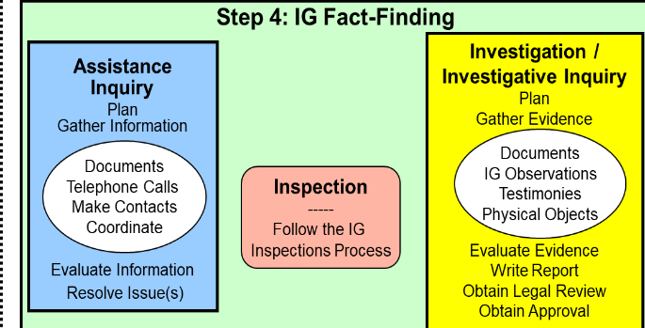
STEP 4:
Fact Finding & Interview
Complainant – Formal interview is REQUIRED during Step 2 OR Step 4
Complainant → Witnesses/SMEs → Suspect
Individuals authorized Special Victim Counsel (SVC) – IG must allow SVC’s presence during interview.
RMO(s) – IG must interview RMO(s) as suspects.
Investigative Plan and Checklist

Slide 46
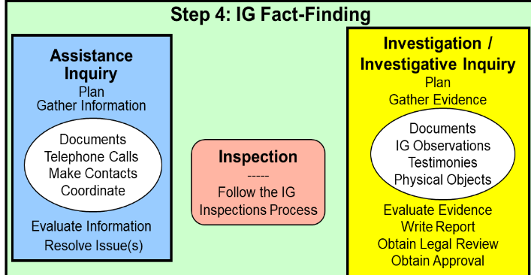
STEP 4: WBR ROI
Standard WBR ROI
  Account for all RMOs, PCs, and PAs
  Directly respond to the four factors/questions
  Exhibit naming conventions
Recommendations
  IG will not recommend specific action
  IG will recommend “Forward the approved Whistleblower ROI to the appropriate commander to consider for appropriate action.”
Legal Review – all WBR ROIs must have an accompanying legal review prior to submission to Whistleblower Division

Slide 47
STEP 5: Notification of Results
The A&I Guide, Part Two, Section 9-5 (II - 9 - 30)
Once DoD IG approves ROI findings-
Whistleblower Division will send final notifications to:
  ACOM / ASCC / DRU
  RMO(s) / Suspects
  Complainants
Office of Inquiry informs the DA and RMO’s Commander
  DO NOT inform complainants, witnesses, or RMOs of findings / recommendations

Slide 48
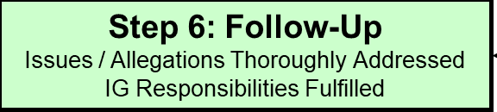
STEP 6: Follow Up
DODD 7050.06 paragraph 1i-j and 2b-d
Military members have the right to appeal the Investigation results directly to the SECDEF
  Since DoD IG approves WBR cases, the Army cannot revise or amend an approved finding without approval from DoD IG.
Reconsideration requests should be referred to the DoD IG website
Should the IG become aware of new information not previously considered, contact Whistleblower Division
Only DoD IG can approve revised findings.

Slide 49
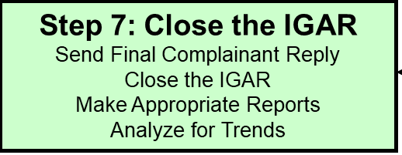
STEP 7: Close the IGAR
Close the case upon DoD IG approval of findings
Final determination for all linked cases in IGARS must reflect the same findings for each as approved by DoD IG
IGs should enter one allegation per RMO and per PA as alleged by the complainant with a determination code of S or N

Slide 50
WBR Report and Referral Chain
DoD IG
Whistleblower Division
Whistleblower Division
Whistleblower Division
Tasking Referral Memo
Report Chain
Referral Chain
10 Days
30 Days
MRCD
(cc ACOM / ASCC / DRU)
ACOM / ASCC / DRU
ACOM / ASCC / DRU
MR/RCN
RIW
DA Form 1559
CCI
Preliminary Fact-finding
ROI
(150 Days)
Field IG
Field IG
Field IG

Slide 51
ELO Check on Learning
ELO 1. Describe the four categories of Whistleblower complainants.
ELO 2. Describe the agency authorized to receive Whistleblower allegations.
ELO 3. Identify what agency is responsible for investigating reprisal allegations for each complainant category.
ELO 4. Describe the four questions (or factors) that establish the framework for an investigation into an allegation of Whistleblower Reprisal (WBR).

Slide 52
Report Comparison
EVALUATE / CLOSE
INVESTIGATE
Evaluate / Close via MRCD
Administrative and Substantive basis
Based on complainant input and documentary evidence
Complaint lacks elements of proof
RMO interviews are not necessary
Must address the elements of proof
Address causation using the 4 variables
Summary WBR ROI:
Not substantiated case
RMO interviews are required
RMO’s reasons for taking the action are supported by strong evidence & unrelated to the PCs
Reliable evidence refutes Complainant’s version of events
Evidence does not support PC (or PA) actually happened
Evidence reveals no knowledge of PC
It becomes clear, mid‐investigation, that we probably shouldn’t have opened the case in the first place
(Standard) WBR ROI:
Substantiated cases and not substantiated cases
Intense Congressional or media interest in case or related events
Cases requiring significant analysis
Robust documentation required

Slide 53
Whistleblower Reprisal
Tool Kit
Receiving the IGAR
Complainant comes in with a reprisal complaint
Do an informal interview, explain what reprisal is and what reprisal is not
  We deal with statutory reprisal as defined in 10 USC 1034 and DODD 7050.06
  We will not stop any ongoing actions
  It is not a way out of trouble you got yourself in
  We are fair and impartial, not complainant advocates
  Determine if it is statutory reprisal or something else (such as an AR 600-20 complaint)
Have the complainant fill out a questionnaire and justification if untimely
Go over the questionnaire with the complainant
  If you don’t understand it, we won’t either
  Make sure the details are specific (i.e. exact dates, actions, names, etc.- squeeze the complainant for details )
  Identify the PCs
  Identify the PAs
  Lay out the timeline
  Identify the documents the complainant must provide and a suspense date
  Make sure the complainant understands we are going to contact the unit for official copies of documents etc.
Beware of documents out of context, get the complete document, be sure you understand exactly what it says.

Slide 54
Whistleblower Reprisal
Tool Kit
Interviews
Complainant interviews are non-negotiable for all WBR cases;
  Rule 1: Do it the way they teach you in TIGS
  Rule 2: Doing it right the first time, will be more efficient in the long run
  Rule 3: For exceptions, see rule number 1
Witnesses and RMOs
Transcribed testimony is always best
Detailed summaries back up by recordings may be acceptable; but they better be detailed, no 1 page MFRs
The value of the interview is in the follow-up questions that elicit detail; the pre-printed question format is normally worthless (usually the hallmark of a lazy IG)
Detailed background research and preparation; know everything you can know prior to the interview
Have a plan, based on the information available, anticipate what will resolve the complaint and how you will get that information from the interviewee
Develop your interrogatory; define success
Organize supporting evidence for rapid access
Rehearse
The more prepared you are, the better you can react to what comes up in the interview
Interviews are interactive—listen to answers and follow-up

Slide 55
Whistleblower Reprisal
Tool Kit
Reports
    Follow the format in the A&I Guide Section II, Chapter 9 Include in your ROI:
For each PC – Need each complaint / PC with
disposition (whatever resolved the complaint,
complete)
  - IG complaint, IGAR, investigative product, result
  - EO complaint, EO inquiry
  - Command inquiry – AR 15-6 (or other report)
  - Regulatory guidance for the action
For each PA – All supporting documentation
  - Art 15 with supporting evidence / documents
  - Separation with all supporting documents
  - Award with DA 638 and unit log (if appropriate)
  - OER / NCOER with drafts, -1, counseling, APFT (HT/WT), and so forth
  - Regulatory guidance for the action
    Establish RMO knowledge (or not) or explain how you resolved and why
    Interview transcripts – Prioritize complainants and RMO (Suspects)
Your inquiry must determine if the action was or was not appropriate given the complainant’s performance, behavior, and conduct or was taken in reprisal for a PC
Your report should leave nothing dangling
  - Answer questions before they are asked
You are writing for someone who is not you --
  - To understand what you found 30 years from now
  - May be Army senior leaders, DODIG, an MOC,
  interest group/media, or some other unanticipated
  agency
Don’t assume, make unsupported suppositions, or leaps of logic; explain everything and peer review your work
  - Do not write a mystery novel, say where you are
  going and go there in a logical manner

Slide 56

Questions?

