Slide 1

Inspector General Issues
“Be Right - Then Forward.”

Slide 2
IG Issues - Why?
Issues that are highly sensitive in nature
IGs often receive IGARs relating to these & new topics
Commander's responsibility -- primarily
IGs must know how to react expeditiously and properly when faced with these issues
Immediate IG knowledge strengthens IG credibility and gives complainants assurance that the IG can help
These matters must not catch IGs by surprise
DROIT ET AVANT!

Slide 3
Terminal Learning Objective
Action: Resolve complaints or issues concerning prohibited relationships; Equal Opportunity regarding sex and sexual orientation; sexual misconduct; suicide; religious accommodations; and trafficking in persons.
Conditions: Given Army Regulation 20-1, Army Regulation 600-20, classroom handouts, and classroom instruction.
Standard: Describe how IGs respond to IGARs concerning Equal Opportunity complaints with regard to sexual harassment; fraternization; sexual orientation; and trafficking in persons.

Slide 4
IG Issues ELOs
ELO
Describe the Army's policy on relationships between Soldiers of different rank, to include social, family, business, and personal relationships.
Identify what office can work complaints regarding discrimination based on sex or sexual orientation.
Describe an IG's actions upon receiving an allegation of sexual harassment or sexual assault.
Identify what office can work a complaint involving sexual harassment or sexual assault.
5. Describe the Army's policy on Combating Trafficking in Persons (CTIP).
6. Describe an IG's actions upon receiving an allegation or an issue involving trafficking in persons.

Slide 5
Safety and Environmental
Safety Requirements: No other specific safety requirements are unique to this block of instruction per DA PAM 385-30, Risk Management, dated 2 December 2014.
Risk Assessment Level: Low in accordance with TRADOC Regulation 385-2, U.S. Army Training and Doctrine Command Safety and Occupational Health Program, dated 14 June 2024.
Environmental Considerations: None in accordance with AR 200-1, Environmental Protection and Enhancement, dated 13 December 2007, and ATP 3-34.5, Environmental Considerations, dated January 2024.

Slide 6
Prohibited Relationships / Fraternization

Slide 7
Army Prohibited Relations / Fraternization Policy
References
AR 600-32, Conduct Between Soldiers of Different Grades
Article 92, UCMJ, Failure to obey order or regulation
DA PAM 600-35, Relationships Between Soldiers of Different Ranks

Slide 8

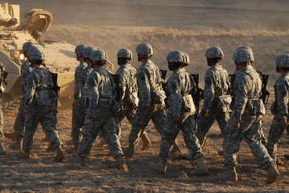


Prohibited Relationship
Policy Applicability
This policy applies to relationships between:
  Army personnel (including military technicians in the USAR and ARNG)
  Army and other military service personnel
  Different sex and same sex
AR 600-32, para. 2-2.a.

Slide 9
Prohibited Relationship Applicability
(continued)
This policy applies to relationships between:
  Officers (to include warrant officers) and enlisted Soldiers
  Noncommissioned Officers (corporal to command sergeant major / sergeant major) and junior enlisted Soldiers (private to specialist)
AR 600-32, para. 2-2.a.

Slide 10
Prohibited Relationships
ELO
1
Between Soldiers of different rank if they:
  Compromise the chain of command
  Cause partiality or unfairness
  Involve improper use of rank for personal gain
  Are exploitative or coercive in nature
  Create an adverse impact on discipline, authority, morale, or mission accomplishment
If they appear to violate any of these standards, they may also be prohibited
AR 600-32, para. 2-2.b.

Slide 11

Prohibited Relationships:
Business
ELO
1
Between officers and enlisted personnel or NCOs and junior enlisted Soldiers
  Borrowing or lending money
  Commercial solicitation
  Ongoing financial
Exceptions
  Landlord / tenant relationships
  One-time transactions (sale of an automobile or house)
  For ARNG / USAR only, business relationships which exist due to their civilian occupation or employment
AR 600-32, para. 2-2.c.(1)

Slide 12

Prohibited Relationships:
Personal
ELO
1
Between officers and enlisted personnel or NCOs and junior enlisted Soldiers, to include Military Technicians in the USAR and ARNG
  Dating
  Shared living accommodations (other than those directed by operational requirements)
  Intimate or sexual relationship
Exceptions
  Marriages
  If change in status of one military member, they have one year to terminate the relationship or get married
  Relationships that primarily exist due to civilian acquaintanceships / associations (USAR / ARNG)
AR 600-32, para. 2-2.c.(2)

Slide 13
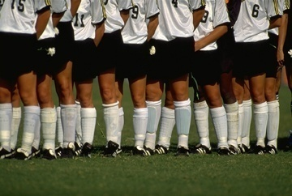
Social & Family Relationships
ELO
1
Associations between military personnel that are not prohibited:
  Community organizations
  Religious activities
  Athletic teams and events
  Unit-based social functions
  Family gatherings
AR 600-32, para. 2-2.d.

Slide 14

Gambling
ELO
1
Gambling between officers and enlisted personnel or NCOs and junior enlisted Soldiers is prohibited.
There are no exceptions.
AR 600-32, para. 2-2.c.(3)

Slide 15
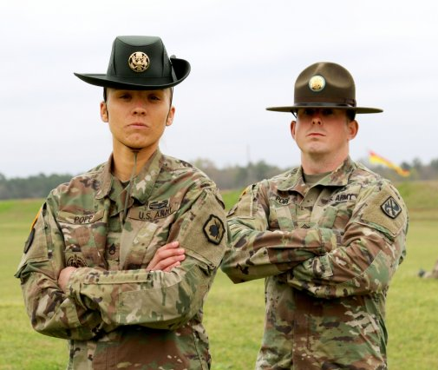
Other Prohibited Relationships
ELO
1
Permanent-party personnel and
IET trainees -- not required by
missions
Permanent-party personnel assigned to U.S. Army
Recruiting Command and . . .
  - Potential Prospects
  - Applicants
  - Future Soldier Training Program (Delayed-Entry Program and Delayed-Training Program)
-- if not required by missions
AR 600-32, para. 3-1

Slide 16
Sexual Orientation

Slide 17
Sexual Orientation
References
AR 600-20, Army Command Policy, para 6-2
Department of Defense (DoD) Directive 1020.02E (Diversity Management and Equal Opportunity in the DoD), June 8, 2015.
Army Directive 2015-39 (Inclusion of Sexual Orientation in the Military Equal Opportunity Program), October 14, 2015.
Memorandum Subject: Approval Process for Service members in Same-Sex Marriages who Request Housing Benefits while Assigned to Overseas Locations, November 17, 2015.

Slide 18
Sexual Orientation Defined
Sexual Orientation. An emotional or physical attraction to the same and / or opposite sex (homosexual, heterosexual, bisexual).
Complaints may be based on actual or perceived sexual orientation, as well as association with an individual or affinity group associated with a particular sexual orientation.

Slide 19
Complaints of
Discrimination
ELO
2
Military Equal Opportunity (MEO) and Equal Employment Opportunity (EEO) will address complaints of discrimination based on sex and sexual orientation
MEO Leader cannot receive formal complaint(s)
Not IG Appropriate (with exception)
Provide impartial, objective, and unbiased advice and oversight to Commanders through relevant, timely, and thorough assistance and investigations as needed. Provide regulatory guidance based on current established DoD and Army policy.
IGs will always adhere to the IG tenet of confidentiality as with any other case

Slide 20
Complaints Involving Suicide

Slide 21
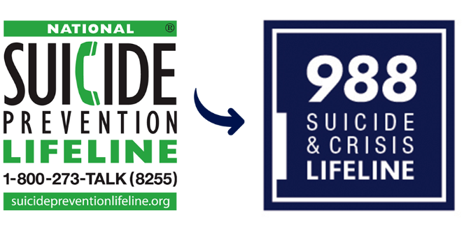
Complaints Involving Suicide
References and Resources
AR 600-63, Army Health Promotion, Chapter 4, para 1-11
AR 600-92, Army Suicide Prevention Program, 4 Oct 24
The Assistance and Investigations Guide, Part One, Section 3-1-9
Army Suicide Prevention Homepage: http://armyresilience.army.mil/suicide prevention
The National Suicide Prevention Lifeline:
      1-800-273-TALK (8255)
      www.suicidepreventionlifeline.org
      www.988lifeline.org
Text 838255
Militarycrisisline.net
Press 1 for military

Slide 22
Complaints Involving Suicide
During the conduct of a case, an IG may face a situation where a complainant expresses suicidal thoughts or the suicidal thoughts of another Soldier
A potential conflict exists between IG confidentiality and taking action to protect an individual by releasing information to third parties

Slide 23

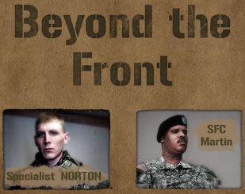


The IG’s Role
Never place IG confidentiality over an individual's safety
Take action to assist (Chaplain)
If the individual declines the IG's assistance and if time permits, contact DAIG's Legal Advisor for a sanity check
Contact the chain of command or medical personnel on an FOUO basis
Listen!
A&I Guide Section 3-1-9

Slide 24
Sexual Misconduct in the Army

Slide 25
Army SHARP Program
References
AR 600-20, Army Command Policy, Chapter 7, Appxs. C, E, F, G, H, I, and J
AR 20-1, Inspector General Activities and Procedures, para. 1-4a (9) (c)
UCMJ, Article 93, Cruelty and maltreatment
UCMJ, Article 120, Rape, sexual assault, and other sexual misconduct
UCMJ, Article 134, Sexual harassment
AR 350-1, Army Training and Leader Development

Slide 26
Army SHARP Program
References
(cont’d)
AD 2021-16, Immediate Actions to Improve the Sexual Harassment / Assault Response and Prevention Program, 5 May 2021
AD 2022-13, (Reforms to Counter Sexual Harassment/Sexual Assault in the Army), 20 Sep 2022
HQDA EXORD 110-22, Sexual Assault Prevention and Response
National Defense Authorization Act (NDAA) 22, Section 543
National Defense Authorization Act (NDAA) 23, Section 546

Slide 27
Sexual Harassment Investigations
The President of the United States established sexual harassment as an offense under Article 134 of the Uniform Code of Military Justice (UCMJ) via Executive Order 14062. The Congress and the Independent Review Commission (IRC) directed the Department of Defense to strengthen sexual harassment investigations as follows:
a. National Defense Authorization Act (NDAA) 22, Section 543 – Requires that an “Independent Investigator” must investigate formal sexual harassment complaints and comply with investigative requirements (e.g., timeliness).
b. NDAA 23, Section 546 – Defines “Independent investigator” as one who is “outside of [the] immediate chain of command of the complainant and the subject of the investigation” and “is trained in the investigation of sexual harassment.” Trained independent investigators must be in place by 27 December 2023. It also changes the definition of sexual harassment in the statute to match Article 134, UCMJ.

Slide 28
What is Sexual Harassment?
Sexual Harassment:
- Conduct that involves unwelcome sexual advances, requests for sexual favors, and deliberate or repeated offensive comments or gestures of a sexual nature
Any use or condonation, by any person in a supervisory or command position, of any form of sexual behavior to control, influence, or affect the career, pay, or job
Any deliberate or repeated unwelcome verbal comment or gesture of a sexual nature by any member of the Armed Forces or Civilian employee of the DoD
Verbal, Non-verbal, physical
- Title 10 USC 1561
- AR 600-20, para. 7-7a.

Slide 29
Who Works Sexual Harassment Complaints?
IGs action for a SH complaint -- must:
  Receive the IGAR, complete DA Form 1559, and open a case in IGARS (complete Steps 1 & 2)
  Look at the larger picture
  Look at the issues that impact:
    Unit cohesion and mission effectiveness
    Acceptable standards of equality and fair play
  Refer / notify the appropriate SHARP personnel
    IGs do NOT investigate SH complaints
ELO
3
ELO
4
NDAA 22 & 23
A&I Guide, Section 3-1-5

Slide 30
What is Sexual Assault?
Sexual Assault:
- Intentional sexual contact characterized by use of force, threats, intimidation, abuse of authority, or when the victim does not or cannot consent.
- Sexual assault includes rape, sexual assault, aggravated sexual contact, abusive sexual contact, or attempt to commit these acts.
AR 600-20, para 7-9

Slide 31
Sexual Assault
Report and Care
DoD Confidentiality Policy offers two reporting options:
  Unrestricted Reporting:
    Receive medical treatment and counseling
    Official investigation
  Restricted Reporting:
    Receive medical treatment and counseling
    Confidentially disclose the crime to specifically identified individuals (Sexual Assault Response Coordinator, Victims Advocate, Healthcare Personnel, Chaplain)
    No official investigation
AR 600-20, Appendix G

Slide 32
The IG’s Role in Sexual Assault IGARs
ELO
3
IGs actions for a Sexual Assault complaint:
Document the case by completing a DA Form 1559 and enter the case in IGARS (Steps 1 & 2)
Notify the Sexual Assault Response Coordinator (SARC) as appropriate
Inspectors General are not a Restricted Reporting Venue and must report ALL complaints of Sexual Assault to CID!
- IAW DoDI 5505.18, "All Unrestricted Reports of sexual assault (and attempts) against adults will be immediately reported to the MCIO [for the Army, this means CID], regardless of the severity of the allegation.”
ELO
4
AR 600-20, Appendix J-1
A&I Guide, Section 3-1-5
Notes:
1). Review the A&I Guide, Section 3-1-5
2). Teach and Train customer that IGs are unrestricted reporting entity and we must report to CID
3). Ensure the customers immediate safety i.e. can they return home etc..
4). Teach and Train customer of SHARP services and request if they want to report this to the SARC – If yes conduct a warm-hand-off
5). IGs are not required to notify the Sexual Assault Response Coordinator (SARC) b/c it is a regulatory requirement for CID. Informing the SARC of the situation helps them maintain awareness of issues within the CMD and be prepared for your DA questions.
6.)IF an IG notifies the SARC in the absence of the customer – they will not provide the victim’s information IOT maintain confidentiality
An IG must report to CID by providing the individuals name, regardless of severity of the allegation and COMPO. One reason you refer to CID is they will determine jurisdiction dependent upon status for NG and USAR Soldiers (title 10, 32) as the incident may not have occurred in an inactive (IDT) status.
Yes, NG/USAR IGs will report to CID regardless of severity of the allegation and COMPO. CID will determine the victim or subjects status (title 10, 32) as the incident may not have occurred in an inactive (IDT) status. As determined by CID they may refer to the appropriate law enforcement agency if not within CID jurisdiction. NG spouse - Same CID reporting applies as does steps 1-6 discussed above but know that DoD civilians, contractors and family members (18 years and older) are limited to unrestricted reporting only and their medical care services may be limited. See DoDI 6495.02 para 2-4.

Slide 33
IGARs Involving Wrongful Broadcast of Intimate Images
Wrongful broadcast or distribution of intimate or sexually explicit visual images of another person
  UCMJ Article 117a (MCM 2019)
  Images of person(s) at least 18 years of age
  Any digital or computer image, picture, film, or video
  Electronically transmit a visual image with the intent that it be viewed by a person or persons (even temporary)
  Does not explicitly consent to the broadcast or distribution
  Reasonable expectation of privacy when made
REPORT TO CID!!! Only CID is authorized to investigate!
Document case in IGARS
Consult your SJA or DAIG Legal

Slide 34
Combating
Trafficking in Persons

Slide 35
Combating Trafficking in Persons (CTIP)
References and Resources
U.S. Laws and Action
  Military Extraterritorial Jurisdiction Act of 2000
  The Trafficking Victims Protection Act of 2000 (P.L. 106-386)
  Trafficking Victims Protection Reauthorization Act of 2003 (H.R. 2620)
  DoDI 2200.01, Combating Trafficking in Persons (CTIP)
AR 600-20, para 4-26
State Department http://www.state.gov/j/tip/
AR 350-1, Army Training and Leader Development
JKO: CTIP General Awareness Training
Army Policy Memorandum dated 24 July 2006
National Human Trafficking Hotline: 1-888-373-7888

Slide 36
Trafficking: As Defined by the Trafficking Victims Protection Act of 2000
Sex trafficking in which a commercial sex act is induced by force, fraud, or coercion, or in which the person induced to perform such an act has not attained 18 years of age; or
The recruitment, transportation, transfer, harboring, or receipt of a person for labor or services through the use of threat, use of force, coercion, fraud, deception, abuse, or exploitation for the purpose of subjection to involuntary servitude, peonage, debt bondage, or slavery.

Slide 37
Trafficking in Persons (TIP) or Human Trafficking
Forms
  Sex tourism and prostitution (includes children)
  Forced labor, domestic servitude, child soldiers
Methods of Coercion
  Fraudulent ads for employment (maid, nannies, modeling)
  Promises of travel
  Threats, intimidation, or violence
Thriving Business
  Poverty, demand for cheap labor, high profits -- low risks
  Political and economic instability, official corruption
  Estimated 30 million people enslaved world-wide
  Multi-billion-dollar business

Slide 38
Army Policy
ELO
5
No leader will turn a blind eye to this issue!
ZERO TOLERANCE for any and all activities associated with human trafficking
Vigorously enforces laws against those who traffic or facilitate trafficking
UCMJ, Article 134:
  - Applies worldwide, on or off duty and on or off a military reservation
  Military Extraterritorial Jurisdiction Act (MEJA)
    Serious Crimes committed abroad by Civilians punishable by US law
Requires commanders to develop a program that includes an assessment of TIP and related issues and awareness training
Army Policy, dated 24 July 2006

Slide 39
The IG’s Role
ELO
6
The IG's actions upon receiving an allegation or an issue involving trafficking in persons:
  Refer the matter to one or more of the following:
    The chain of command
    CID
    Local law enforcement
TIP is inherently criminal and not appropriate for IG action!
AR 20-1, para. 6-3k

Slide 40
Accommodating Religious Practices

Slide 41
Accommodating Religious Practices References
Standards:
  Religious Freedom Restoration Act (RFRA), 42 U.S.C. . § 2000bb
DODI 1300.17, Accommodations of Religious Practices Within the Military Services.
AR 600-20, Chapter 5, para. 5-6, Army Command Policy
Army Directive 2016-34 (Processing Religious Accommodation Requests Requiring a Waiver to Army Uniform or Grooming Policies), 6 October 2016
Army Directive 2018-19 (Approval, Disapproval, and Elevation of Requests for Religious Accommodation)

Slide 42
Accommodating Religious Practices
1. AR 600-20 directs RA Process and Authorities
AR 600-20 allows 30 days from Soldier’s request to GCMCA decision
RA is a commander’s responsibility and a readiness issue. RA enhances mission accomplishment, sustains positive command climate, and fosters respect
Decision Authority - Unit commander? GCMCA? DAG1? OTSG?
2. Chaplains are the command team’s religion SME
Chaplains advise Army command teams on military religious exercise
Chaplains determine if requestor demonstrates religious basis and sincerity of belief
RA request requires a chaplain formal interview and memorandum
3. Religious Freedom Restoration Act (RFRA) is the RA Standard
The individual’s connection with the divine is the religious standard, and not an established religion’s standard
Criteria for religion demonstrates: 1) Transcendence, 2) Comprehensive Belief System; 3) External signs of devotion and ritual with moral code
Sincerity is congruence of faith and practice. Indicators/discriminators can include duration, community participation, religious leader endorsement, whole of life impact
Proponency Assistant Directorate/Army Office of the Chief of Chaplains

Slide 43
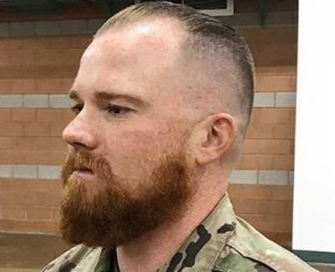

Accommodating Religious Practices
Five major areas:
  Worship practices
  Dietary practices
  Medical care (including immunizations)
  Wear and appearance of the uniform (Religious Items; Modesty)
  Personal Appearance and Grooming Practices
Distinct approval authority levels depending on religious accommodation request(s); ranges from informal accommodation by unit commander to SECARMY (or designee).
Accommodation of a Soldier's religious practices must be examined against military necessity and cannot be guaranteed.
AR 600-20, para. 5-6

Slide 44
Accommodating Religious Practices
Decision Authority (DA) - Unit commander? GCMCA? DAG1? OTSG? (AR 600-20)
DA-NONE: Routine Requests where no waiver or unit command approval is required. Relates to issues specifically permitted by AR 670-1. Command approval is not required but should be aware. *This includes opportunity to participate in religious services, wear of religious bracelets, Kufi, Yarmulke, etc.
DA-Unit Commander: Routine Requests where unit command approval is required, but not effected by AR 670-1. Unit commanders may approve formal or informal waiver/exception from standards/uniformity rather than waiver from Army-wide policy/regulations. *i.e. temporary or permanent adjustments to work and duty rosters/schedules, wear of long APFT pants during PT, Religious MREs, etc.
DA-GCMCA: Uniform and Grooming Requests requiring approval by GCMCA. Uniform and Grooming Standard Waivers for hijabs, beards, turbans IAW AR 600-20 and AR 670-1.
DA-HQDA: Uniform and Grooming Requests requiring approval by Secretary of the Army or other *This includes requests of Army-wide policies/regulations exceeding GCMCA approval authority. *i.e. Surgeon General - Medical Boards, immunizations, DAG1 - beard length exceeding 2”, uncut hair, Jewish payots (ringlets), head coverings exceeding AR 670-1, etc.

Slide 45
Religious Accommodations
The IG’s Role..
Get left of the problem
Teach and Train on AR 600-20
  Company Commander and First Sergeant Course
  Recommend Officer Professional Development / Noncommissioned Officer Development Program
  Newcomer’s Orientation
  Pre-deployment Training / Briefings
  During receipt of IGAR
  - Explain the specific provisions of AR 600-20
  - Provide guidance on how to submit a request

Slide 46
Reporting Prohibited Activities

Slide 47
Reporting Prohibited Activities
References and Resources
DODI 1325.06, Handling Protest, Extremist and Criminal Gang Activities Among Members of the Armed Forces
Army Directive 2024-07 (Handling Protest, Extremist and Criminal Gang Activities), 14 June 2024
Army Directive 2024-08 (Reporting Prohibited Activities (RPA)), 14 June 2024
  Temporary Prohibited Activities Notification Process, 2 July 2024
MS Teams Channel: Reporting Prohibited Activities

Slide 48
Reporting Prohibited Activities
Military personnel are prohibited from actively participating in extremist activities.
Commanders have the authority and responsibility to prohibit Servicemembers from actively participating in extremist activities and any other activities…
Conduct is punitive, and violations may subject offenders to nonjudicial or judicial action under the Uniformed Code of Military Justice (UCMJ).
Appropriate Army Authorities (AAA) will notify subject’s commander and Army IG within 30 days (AC) / 60 days (RC) of receipt of allegation
Army IGs will promptly forward reported information IAW Temporary Prohibited Activities Notification Process utilizing DAIG Prohibited Activities Notification Form
  Call 703-614-2733 to obtain a DAIG Control Number for an initial notification
  Email (Encrypted CUI NIPR) to: usarmy.pentagon.hqda-otig.mbx.saig-ai-office@army.mil
Do NOT enter into IGARS!

Slide 49
Reporting Prohibited Activities
Extremist activities are defined as:
Advocating or engaging in or encouraging personnel to violate the laws of the United States, or any political subdivision thereof for the purpose of disrupting military activities.
Advocating widespread unlawful discrimination based on race, color, national origin, religion, sex (including pregnancy), gender identity, or sexual orientation
Advocating or engaging in unlawful force, violence or other illegal means to:
  Deprive people of their rights
  Achieve goals that are political, religious, discriminatory, or ideological in nature
  Support terrorism
  Overthrow or alter the Government of the United States for any political subdivision thereof.
Active Participation means:
Advocating or engaging in the use or threat of unlawful force or violence in support of extremist activities.
Advocating or supporting individuals or organizations that promote extremist activities through: material, resources, information, recruiting/training, funds/fundraising, leading, creating, rallying, attending meetings, promoting or distributing/receiving/displaying literature or other paraphernalia, accessing websites on government systems or engaging in electronic/cyber activities.

Slide 50
Reporting Prohibited Activities
AAA will collect and report, through Army Inspector General (IG) channels, all allegations of Soldier engagement in prohibited activities to the Department of Defense Deputy Inspector General for Diversity, Inclusion and Extremism in the Military (DIG(DIEM)) as described in the following table.

Slide 51
IG Issues - Why?
Issues that are highly sensitive in nature
Commander's responsibility -- primarily
IGs often receive IGARs relating to these and new topics
IGs must know how to react expeditiously and properly when faced with these issues
Immediate IG knowledge strengthens IG credibility and gives complainants assurance that the IG can help
These matters must not catch IGs by surprise
DROIT ET AVANT!

Slide 52
Check on Learning
The Army's policy on relationships between Soldiers of different rank has exceptions for business and personal relationships. What are they?
Business: Landlord/tenant, one-time transaction, and for reserve only - due to civilian occupation/employment
Personal: Marriages, The one-year rule and for reserve only – primarily exist due to civilian acquaintanceships/associations
… And for what activity is there no exception?
Gambling
Are IGs authorized to investigate allegations of sexual harassment or assault?
NO
… Who is authorized to investigate?
Harassment – Appointed investigator who is SHIC trained and outside the immediate chain of command
Assault - CID

Slide 53
Summary
Described the Army's policy on relationships between Soldiers of different rank, to include social, family, business, and personal relationships.
Identified what office can work complaints regarding discrimination based on sex or sexual orientation.
Described an IG's actions upon receiving an allegation of sexual harassment or sexual assault.
Identified what office can work a complaint involving sexual harassment or sexual assault.
5. Described the Army's policy on Combating Trafficking in Persons (CTIP).
6. Described an IG's actions upon receiving an allegation or an issue involving trafficking in persons.

Slide 54

Questions?

