Slide 1
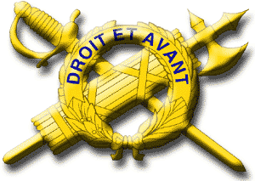
U.S. Army
Inspector General
Concept and System

Slide 2
Reference:
Army Regulation 20-1,
Inspector General Activities and Procedures
Chapters 1, 2, 3, and 4
Enabling Learning Objectives
(ELOs)
Advance Sheets, page 5
ELO

Slide 3
Enabling Learning Objectives
Identify the four functions that IGs perform.
2. Describe the legal origins of IG authority.
3. Describe the role of the IG.
4. Describe the organization of the Army IG system.
5. Describe the IG’s sphere of activity.

Slide 4
Enabling Learning Objectives
(continued)
6. Describe IG technical channels.
7. Describe the categories of IGs and the responsibilities inherent in each category.
8. Describe the duty restrictions of IGs.
9. Describe the duty restrictions and special considerations of Administrative Support Personnel.
10. Describe the IG oath.

Slide 5
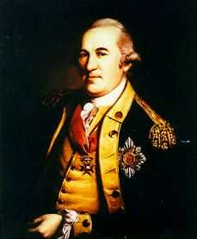
Foundational Precepts
Historical constants developed over 240+ years of Army IG history
1. The IG-Commander Relationship
- Developed at Valley Forge in 1778 by General Washington and Baron von Steuben
- Holds true today and remains inviolable
2. The von Steuben Model
- Readiness and warfighting
capability
- Serves as both a guiding
philosophy and a paradigm for
the Army IG system

Slide 6
The U.S. Army IG System
A History of Negative Perceptions Caused by
a Compliance-Based System
World War One (1917-1918): Selective Service Act of 1917 (draft).
  General Pershing wanted a system of pre-combat inspections for each U.S. division before it went into the line.
  MG Brewster, Pershing's IG, established a compliance-based inspection program to help commanders improve readiness.
World War Two (1941-1945): Continued with the draft.
  Brewster's inspection program morphed into the Army's Annual General Inspection (AGI).
Korea and Vietnam (1950-1975): The draft remained in place.
  The AGI remained a cultural staple of Army readiness efforts well beyond the All-Volunteer Force of 1973.
But the Army changed after Vietnam. Commanders no longer appreciated or needed the AGI because the draft was gone.

Slide 7
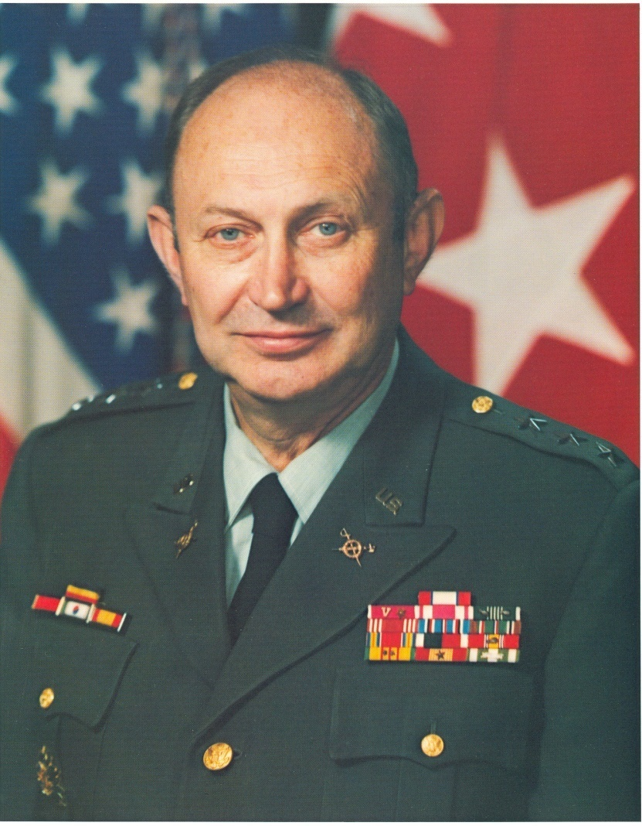
LTG Richard G. Trefry
November 1977 -- September 1983
Most significant TIG since von Steuben.
Recognized the problems of continuing with the old "black hat" AGI in the context of an All-Volunteer Force.
Changed the Army IG Inspections paradigm from compliance to systemic to focus IGs on the health of the Army's multitude of systems.

Slide 8
Systemic Issue
A Pattern of Non-Compliance
For example -- Small-Arms Repair Parts
Nearly every battalion in the division has the same problem:
Parts do not arrive when ordered properly.
A
G
B
F
C
H
E
D
IG “Rule of Thumb”: Three or more represents a trend.

Slide 9
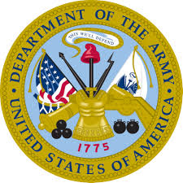
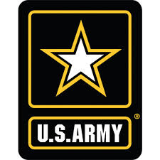

Recruiting
Army’s Title 10 Functions
Constructing,
Mobilizing / Demobilizing
Organizing
Administrating
Training
Supplying
Equipping
Servicing
Outfitting, Repairing
Field Operating
Secretariat
Army Staff
Field Operating
HQDA
Secretariat
Army Staff
Agencies
Agencies
ACOM /
ASCC / DRU
Corps
Division
Logistics, Services (G
Unit Ministry (Chaplain)
Resource Management
Intelligence, Security (G
Medical Care (Surgeon)
Brigade
Readiness, Mobilization (G
Financial Management (G-8)
Civil Affairs Operations (G-9)
Personnel, Administration (G
Information Operations (G-6)
Organizational Levels
Battalion
Operations, Plans, Training (G-3/5/7
Military Justice, Legal Services (JAG)
Command Information, Public Affairs
Installation Support and Infrastructure
Company
-
-
4)
2)
Platoon
-
-
3)
1)
Squad
FM 6-0
Soldier
Soldier
Fully Mission
Capable
Soldiers and Units
All systems structured in line with DOTMLPF-P: Doctrine–Organization–Training–
Materiel–Leadership and Education–Personnel–Facilities-Policy
Army Core Enterprise Concept:
Human Capital, Materiel, Readiness, Services, and Infrastructure

Slide 10
The U.S. Army IG System
Today
ELO
1
Comprises four basic Inspector General functions:
  Teaching and Training
  Inspections
  Assistance
  Investigations
Inspectors General put this system into practice using two basic processes:
  The Inspections Process
  The Inspector General Action Process (IGAP)
Army Regulation 20-1, paragraph 1-7 (functions) and Chapters 5, 6, and 7 (processes)

Slide 11
IG Functions
IGs adapt the Army IG system to meet the specific needs of the Commanders and organizations they serve.
By performing the four IG functions to enhance the command’s readiness and warfighting capability, IGs are providing Oversight, Insight, and Foresight to their Commanders.
OVERSIGHT
Commander =
Commanding General / Directing Authority
INSIGHT
FORESIGHT
Army Regulation 20-1, paragraph 1-6

Slide 12
Inspector General Mission
Title 10, U.S. Code, Section 7020
ELO
2
Periodically propose programs of inspection to the Secretary of the Army and shall recommend additional inspections and investigations as may appear appropriate.
Cooperate fully with the IG, DoD, in connection with the performance of any duty or function of the IG, DoD.
Inquire into and report upon the discipline, efficiency, and economy of the Army.
Perform other duties prescribed by the Secretary or the Chief of Staff of the Army.
* NOTE: FY19 NDAA changed Section 3020 to Section 7020.
Army Regulation 20-1, paragraph 1-6 a

Slide 13
Mission Comparison
10 USC 7020 versus AR 20-1
Inquire into and report upon the discipline, efficiency, and economy of the Army.
Inquire into, and periodically report on, the discipline, efficiency, economy, morale, training, and readiness of the Army to the Secretary of the Army (SECARMY) and the Chief of Staff, Army (CSA).
Army Regulation 20-1, paragraphs 1-4 a (1) and 1-6 a

Slide 14
The Federal IG System
Significantly Different from the Army IG System
1978 Inspector General Act
Established IGs at Federal agencies (except Department of Defense, or DoD).
Focused on detecting and preventing fraud, waste, abuse, and mismanagement.
Mostly auditors and criminal investigators.
Report to the agency head and Congress.
1983 DoD Authorization Act (amended the 1978 IG Act)
Created IG, DoD.
Nominated by the President / confirmed by the Senate.

Slide 15
IG Attributes
IGs must embrace and exemplify Army Values, the Warrior Ethos, and the Army Civilian Corps Creed.
IGs hold positions of public trust and uphold the moral principles of the Army Ethic: Honorable Servants, Army Experts, and Stewards of the Army Profession.
IGs require broad experience, strong written and verbal communication skills, and impeccable ethics.
Army Regulation 20-1, paragraph 1-7 b

Slide 16
IG Credibility
Credibility directly impacts your effectiveness!
IGs are held to a higher standard
Be right the first time -- every time
Don’t shoot from the hip
IGs are always above board but discreet
IGs are never off the record
Moral courage is mandatory
Integrity is essential
Army Regulation 20-1, paragraphs 1-7 f (1) and 2-5 a (2)

Slide 17
Command IGs
Army Regulation 20-1, paragraphs 1-7c and 1-7e (3)
Each IG staff section assigned to a command or any of the States or territories has a commissioned officer or Civilian designated as the Command IG.
The Command IG is a member of the Commander’s personal staff, and the Commander rates and senior-rates the Command IG.
Only Regular Army and Air Force commissioned officers in the grade of colonel or lieutenant colonel may serve as State Command IGs.
The Command IG leads the IG staff section and works directly for the Commander or, in the case of the States, the State AG.
The Command IG communicates the Commander’s vision, intent, philosophy, and guidance to the IG staff section members, who then perform the four IG functions within the command or State based upon this guidance.

Slide 18
IG-Commander Relationship
All Inspectors General extend the eyes, ears, voice, and conscience of their Commanders.
The IG-Commander relationship represents the foundation of the Army IG system.
This relationship is one of extraordinary trust and confidence, affording the Command IG (and the IG staff section) a high degree of independence and unlimited access to information in performing IG duties.
The Commander has a responsibility to learn and understand the IG system.
Command IGs and their staff sections must remain exclusively under the Commander’s direct authority (without further delegation) to avoid any possibility or perception of external influence.
Army Regulation 20-1, paragraph 1-7 e

Slide 19
The Role of the IG
Extend the Commander
ELO
3
IGs have both formal and informal roles within the command.
The formal role occurs when IGs perform the four IG functions.
The informal role occurs by advising the Commander (CG / DA) and subordinate commanders on matters affecting the command's immediate readiness, often in real time.
IGs must continuously work through and with the chain of command if the IG system is to be viable, effective, and relevant.
The IG system must reinforce and bolster the chain of command at all times without undermining it.
Army Regulation 20-1, paragraph 1-7 f

Slide 20
Organization of the
Army IG System
ELO
4
Each general officer in a command position has a Command IG (or State IG) and an IG staff section.
The Army IG system is decentralized -- Command IGs work for their general-officer Commanders, and TIG provides oversight.
IGs are in the Active Army, the Army Reserve, and the Army National Guard.
IGs are normally found in:
  Divisions and Corps
  States and Territories (Army National Guard)
  Headquarters, Department of the Army (HQDA)
  Army Commands (ACOMs), Army Service Component Commands (ASCCs), and Direct-Reporting Units (DRUs)
  Wartime General Officer Major Subordinate Commands (MSCs)
  TRADOC Centers of Excellence
* The Division IG
staff section is the
foundation
of the Army IG system
Army Regulation 20-1,
paragraphs 1-7 d (2) and 2-1

Slide 21
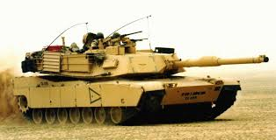
IG Sphere of Activity
Army Regulation 20-1, paragraph 1-7 h
ELO
5
Includes everything for which the Commander is responsible and over which the Commander or State Adjutant General has Federal authority.
Determines IG case
jurisdiction.
  Watch Your Lane!

Slide 22
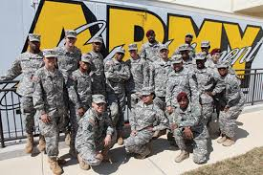
IG Technical Channels
Army Regulation 20-1, paragraph 1-7 i
ELO
6
Technical channels guarantee the effective functioning and value of the IG system.
IGs may request, and are normally expected to provide, assistance to others within the IG system (formally or informally).
A vertical command relationship for IGs does not exist. IGs work for their Commanders and not for other IGs.
Use the World-Wide IG Directory on the IG Network (IGNET).
Share IG opinions
and IG products

Slide 23
IGs and Command Policy
IGs are obliged to assist Commanders and staffs in developing effective policies.
However, IGs will not establish command policy except as provided by TIG through AR 20-1 and AR 1–201.
IGs must point out conflicts in policy to ensure accuracy.
IGs will not overtly concur or non-concur with draft or emerging policies to avoid the perception that an IG may have a personal stake in that policy.
The IG’s final response will be “reviewed with comments” or a similar statement, but the IG will avoid the terms "concur" or "non-concur."
Army Regulation 20-1, paragraph 1-7 j

Slide 24
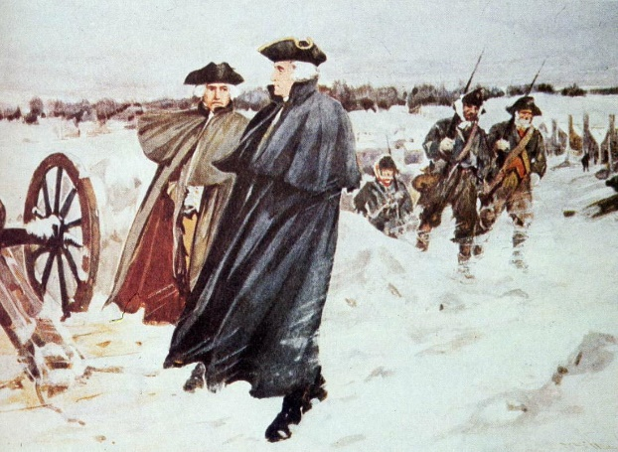
IGs and Command Policy
(continued)
The IG's authority comes from the Commander.
IGs have no directive authority outside the IG System
and cannot inspect or investigate
without the Commander’s
written approval.
Army Regulation 20-1, paragraph 1-7 j

Slide 25
IG Access to Information
Army Regulation 20-1, paragraph 1-8
No officer, employee, Service member, or DoD component may deny IGs access to all documents, records, and evidentiary materials needed to discharge their duties.
Examples include classified documents, records of board proceedings, emails, acquisition information, medical records, financial records, evaluation reports, criminal investigation reports, and so on.
When accessing medical records, IGs must remain aware that health-care information is sensitive medical information protected by the Health Insurance Portability and Accountability Act (HIPAA).
IGs are also authorized access to classified or sensitive information but must present proof of an appropriate level security clearance or special access to review classified documents.

Slide 26

DAIG Organization
Office Symbol: SAIG
1,487 Field IGs Authorized
(+209 in DAIG)
Secretary
of the Army
The Inspector General (TIG)
Command Counsel / Legal Office
Inspector General
Sergeant Major
OTIG
Deputy The Inspector General (DTIG)
Operations & Support Division
Inspections Division
SID (x3), Intelligence Oversight, Cybersecurity, Technical Inspections
OP
ID
DIVISION CHIEFS
The Inspector General School
Information Resource Management Division
IR
TR
U.S. Army Inspector General Agency
Assistance Division
AC
RS
Records Screening Division
Investigations Division
IN
AI
Analysis & Inspection
Follow-up Office
Location
Pentagon
IO
Taylor Building
TIG = The Inspector General
DTIG = Deputy The Inspector General
OTIG = Office of The Inspector General
Fort Belvoir

Slide 27
IG Functions
Confidentiality
IG Records
Inspections
Teaching
and
Training
Assistance
Investigations

Slide 28
Confidentiality
Army Regulation 20-1, paragraph 1-13
Key tenet of IG operations.
Complainants expect confidentiality.
Confidentiality = safeguarding identities and the nature of the complaint or information provided.
Intent =
  Protect privacy
  Maintain confidence in the IG system
  Minimize the risk of reprisal
An IG’s duty is to PROTECT confidentiality . . .
But IGs never guarantee confidentiality!

Slide 29
IG Records
Army Regulation 20-1, Chapter 3
Most information gathered by an IG becomes an IG record.
IG records cannot be used for adverse action (paragraph 3-5).
All IG records belong to the Secretary of the Army, but TIG is the designated release authority.
DAIG’s Records-Release Office (SAIG-JAR) redacts all IG records for attribution before release for official use.
Inspection
Report
(least
restrictive)
Report of
Investigation
(most
restrictive)
IGs generate two basic reports – one is more restrictive in terms of release than the other.

Slide 30
Punitive Provisions to
Army Regulation 20-1
Persons subject to Army Regulation 20-1 will not restrict anyone from lawfully communicating with an IG; Member of Congress (MC); or a member of an audit, inspection, or law enforcement organization within the Department of Defense, including Department of Defense IGs and IGs of other Services and Federal agencies.
Persons subject to this regulation will not knowingly make an unlawful communication with an IG, MC, or the Office of Special Counsel (OSC).
An unlawful communication is a false official statement under Article 107, Uniform Code of Military Justice.
Army Regulation 20-1, paragraph 1-14

Slide 31
Categories of IGs
Army Regulation 20-1, Table 2-1
ELO
7
= Must attend TIGS Basic Course
Category | Grade | Inspections | Assistance | Investigations | Teaching and Training
Inspector General | - CPT -- COL - CW3 -- CW5 - GS-11 -- GS-15 | Lead / Assist | Lead / Assist | Lead / Assist | Lead / Assist
Assistant IG | - SSG (P) -- SGM - GS-9 | Lead / Assist | Lead / Assist | Assist | Lead / Assist
Temporary Assistant IG | Officers, WOs, NCOs, and DACs | Assist | Assist | Assist | Assist
Acting IG | - CPT -- COL - GS-11 -- GS-15 | No | Basic Assistance (with supervision) | No | Assist
Admin Support | - Per MTOE / TDA | No | No | No | Assist (support only)

Slide 32
IG Duty Restrictions
Army Regulation 20-1, paragraph 2-7
ELO
8
Inspectors General, Assistant IGs, Temporary Assistant IGs,
or Acting IGs will NOT:
Be assigned to any non-IG assistance, evaluation, or investigations functions.
Be assigned duties that may disqualify them from conducting impartial Inquiries / Investigations.
Serve on local administrative separation boards, promotion boards, contracting awards boards, etc.
Sitting on courts-martial panels is allowed.
Bottom line: Avoid conflicts of interest or
compromising your impartial status!

Slide 33
Duty Restrictions for Administrative Support
Personnel
ELO
9
Administrative support staff members are Soldiers and Civilian employees who serve in administrative support positions (such as administrative assistants, secretaries, drivers, computer operators, clerks, typists, and so forth).
They take the IG oath because they have access to IG records and the IGARS database.
Administrative Support staff members may not lead or participate in any of the four IG functions.
Administrative support staff members are not required to attend TIGS’s Basic Course but are strongly encouraged do so on a space-available basis.
The Command IG may designate school-trained administrative support staff members to serve for specified periods of time as Assistant IGs when circumstances require increased capability within the IG staff section.
Army Regulation 20-1, Table 2-1 and paragraph 2-2 h

Slide 34
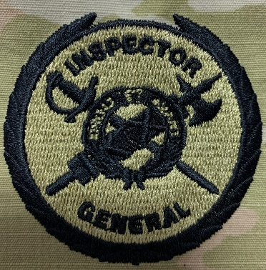
IG Certification
Army Regulation 20-1, paragraphs1-4 a (11) (d), 2-4, and 4-2 b (1); Appendix B
Military IGs:
  Nomination (packet generated locally or by Human Resource Command).
  Selection, or nomination approval.
  Training (qualification) at TIGS’s Basic Course.
Civilian IGs:
  Selection and hiring by the local Command IG.
  Top 3 selectees screened against IG database.
  Training (qualification) at TIGS’s Basic Course.
IGs serve in a position of public trust and must adhere to the standards for exemplary conduct outlined in 10 USC 7233 (formerly 3583).
All IGs will “Assist commanders in teaching and training leaders on the moral principles of the Army Ethic.” (Army Regulation 600-100, Army Leadership, paragraph 2-3 e)
Army IG Badge

Slide 35
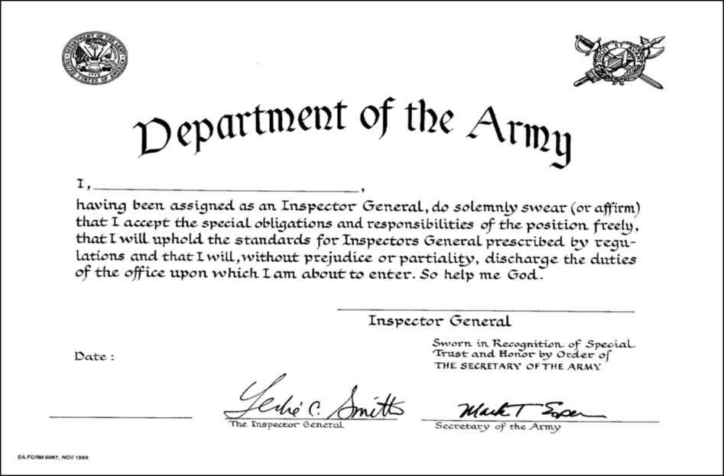
The IG Oath
Army Regulation 20-1, paragraph 2-6
ELO
10
Established in 1981 to strengthen
the bond between the Commander
and the IG.
Emphasizes special trust and
responsibility.
Normally administered by the
Commander.
Taken by all categories of IGs and everyone working in the IG office.
Documented with a certificate.
“… uphold the standards … without prejudice or partiality …”

Slide 36
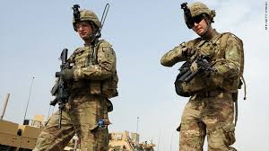
Some Little-Known Facts
Inspectors General . . .
Always encourage complainants to use the chain of command first.
Refer allegations to subordinate Commanders for action rather than conduct an IG Investigation.
Use discretion when passing information to the Commander.
Are here to help you.
Tell good-news stories.
Do not wear a ‘black hat.’
Do have friends!

Slide 37
Summary
Identify the four functions that IGs perform.
2. Describe the legal origins of IG authority.
3. Describe the role of the IG.
4. Describe the organization of the Army IG system.
5. Describe the IG’s sphere of activity.

Slide 38
Summary
(continued)
6. Describe IG technical channels.
7. Describe the categories of IGs and the responsibilities inherent in each category.
8. Describe the duty restrictions of IGs.
9. Describe the duty restrictions and special considerations of Administrative Support Personnel.
10. Describe the IG oath.

Slide 39
IG Concept
and
System Overview
QUESTIONS?

