Slide 1
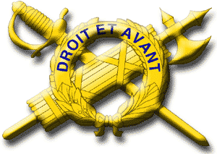
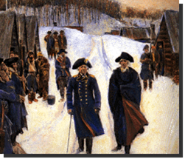
History of the U.S. Army Inspector General System

Slide 2

Point of Contact

Slide 3
References
IG Reference Guide, Part 1, History of the U.S. Army Inspector General
The Inspectors General of the U.S. Army: 1777 – 1903, David A. Clary and Joseph W.A. Whitehorne
The Inspectors General of the U.S. Army: 1903 – 1939, Joseph W.A. Whitehorne
http://tigs-online.ignet.army.mil/tigu_online/History.htm

Slide 4
Enabling Learning Objectives (ELO)
ELO
Reference: Advance Sheets, page 4
Describe the origins of the IG system
Describe the reasons why von Steuben was the first effective IG
Describe the von Steuben model and why IGs adhere to that model today
Describe the meaning of the IG crest

Slide 5
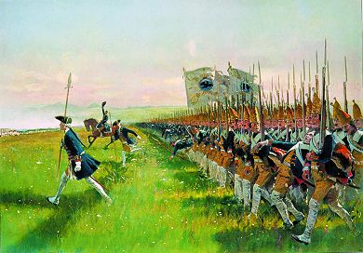
Why Inspectors General?
Armies were becoming larger and more complex
Soldiers and armies were changing
Standardization and
discipline were needed

Slide 6

Origins of the IG System
ELO
1
French – 1668
  Worked for the King
  Full authority to punish
  Geographic focus
The American
Inspector General
Prussian – 1750
  King’s “eyes and ears”
  Drill and discipline
  Improve unit efficiency
British – 1760
  Functional areas
  An additional duty
  Enforce accountability
  Force sustainment functions
IG Reference Guide, page 1-4

Slide 7

First American “Inspector”
April 1777 -- Commissary Inspector
"An army marches on its stomach..."
Napoleon Bonaparte

Slide 8
American Agents in France
Benjamin Franklin, Arthur Lee, John Adams, and Silas Deane
Mission:
  Recruit experienced military leadership
  Get French into the war
  Secure financing

Slide 9
Early American IGs
Augustin Montin de la Balme
  Recruited by Ben Franklin
  Cavalryman
  May 1777 - Lieutenant Colonel of Horse
  July 1777 - Inspector General of Cavalry
  Resigned in protest October 1777
Killed in action 1780

Slide 10


Early American IGs
Phillipe Charles Jean Baptiste Tronson du Coudray
  Recruited by Silas Deane
  Major General, Artillery Chief
  IG of Ordnance and Military Manufactories
  Pompous troublemaker
  16 September 1777
→ Historic ride

Slide 11
Council of 14 Generals
29 October 1777
Convened by Washington
Proposed duties of Inspector General:
  Serve as drillmaster general
  Establish uniform tactics
  Publish manual on drill
  Organize and lead training
  Ensure troop proficiency

Slide 12
Congressional Resolution
13 December 1777
Authorized two Inspectors General
IG would report findings directly to Congress (Board of War (BoW))
BoW regulated and made all tactical and strategic decisions for the Army
Commander was responsible for tactical operations

Slide 13
Congressional Resolution
13 December 1777
IG procedures and responsibilities:
  Notify regimental commanders of their reviews
  Have commanders prepare return lists in triplicate
    Equivalent of today’s Unit Status Report
  Talk to and observe unit personnel and equipment
  Produce regulations for maneuvering the troops
The first US Army IG was Brigadier General Thomas Conway

Slide 14
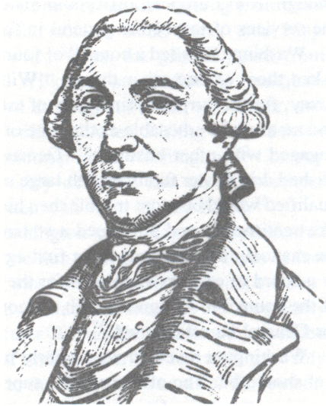
First United States Army Inspector General
Brigadier General Thomas Conway
  Irish born, 20+ years in the French Army
  Recruited by Silas Deane
  Member of Council of 14 Generals
  Self-serving, pompous braggart
Promoted and sent to Valley Forge
Washington dismissed him as he provided no manual for instructing Soldiers as directed by Congress
Bottom Line: Army wasn’t big enough for both Washington and Conway!

Slide 15
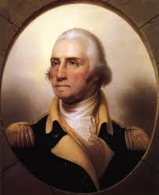
Washington’s IG Concept
Appealed to Congress
Detailed his IG concept
Commander-in-Chief:
  Accountable to civil authority (Congress)
  Selects his own IG
IG answers to the Commander -- not to Congress

Slide 16
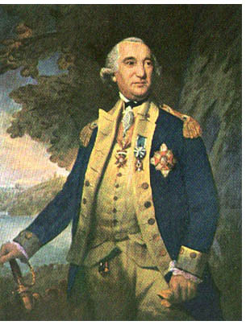
Baron Friedrich Wilhelm Augustus Heinrich von Steuben
Recruited by Ben Franklin
  Served as a volunteer at the age of 14
  Entered Prussian Army in 1747
  Served on Frederick the Great’s staff
  First at Frederick the Great's staff college
  Retired after 28 years of service as a Captain
  Bankrupt and jobless – a failure
  in civilian life
Franklin “embellished” records (Captain to Lieutenant General)
Credentials given to Congress in December 1777
Ordered to Valley Forge and arrived in February 1778

Slide 17
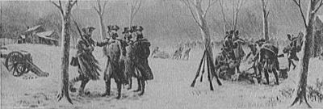
Situation at Valley Forge
“The situation of the camp is such that in all human probability the Army must soon dissolve.”
“There is no meat, the horses are dying, and the bare country surrounding is a poor location for a camp.”

Slide 18
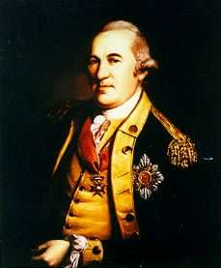
Situation at Valley Forge
“Nothing was so difficult and often impossible
as to get a correct list of the states or return of
any company, regiment or corps.”
“In our European armies a man who
has been drilled for three months is
called a recruit; here, in two months, I must have
a Soldier!”
-- Baron von Steuben

Slide 19
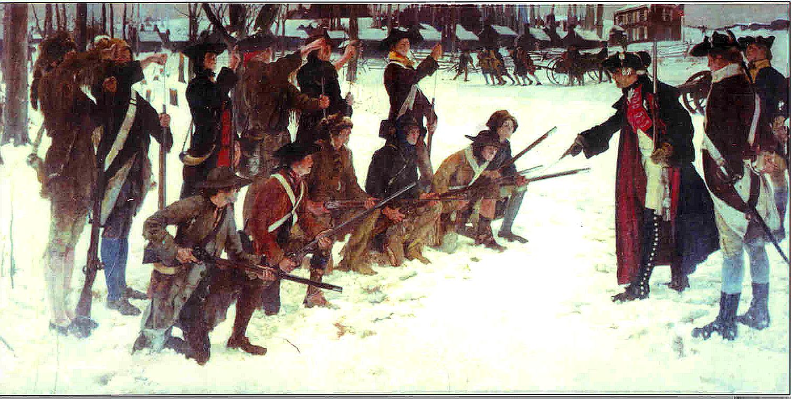
Drillmaster
General von Steuben
In March 1778, he trained one squad of
Washington’s guard
Sub-inspectors
trained squads
while von Steuben
supervised the
trainers
Daily company drill and weekly inspections

Slide 20
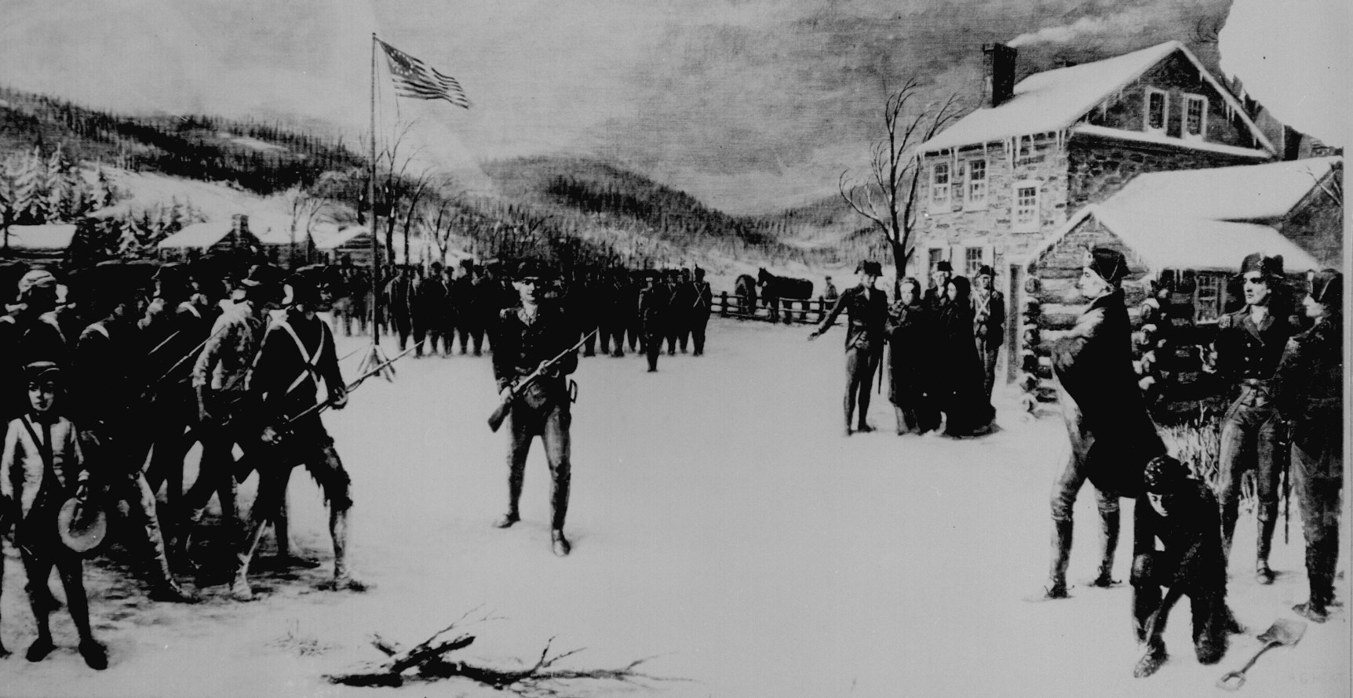
Inspector General von Steuben
Appointed IG in March 1778 by Washington
Confirmed by Congressional appointment in May 1778 and:
  Promoted von Steuben to Major General
  Established IG
  positions to brigade level
  Authorized commander
  to appoint IGs
  Authorized additional
  pay for IGs!

Slide 21
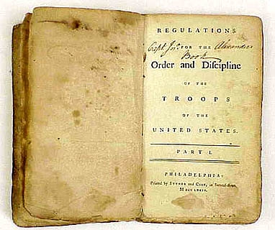
The first effective U.S. Army IG: Major General von Steuben
ELO
2
Standard regulations and tactics
  Codified in the “Blue Book”
Acted under Commander’s intent
Respected by subordinate commanders
Won Commander’s support
and confidence
The IG Reference Guide, pages 1-5 and 1-6

Slide 22
1790 ~ 1813
1790s: TIG was second in command
After 1800
  IG duties assigned to Adjutant General
  Position of IG was eliminated in 1812
1813: Army staff reorganized
  Inspector General's Department established
  TIG, eight inspectors general, and many assistant inspectors general
  No centrally developed doctrine that clearly defined the role of the IG

Slide 23
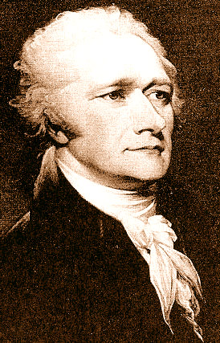
Alexander Hamilton
July 1798 ~ June 1800
Notable
TIG
The Inspector General (TIG) was the last public office he held
Killed in a duel with Aaron Burr in 1804

Slide 24
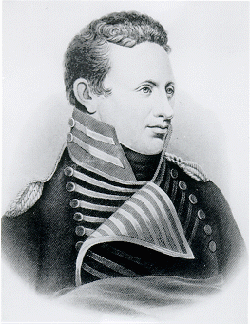
Zebulon Pike
March ~ April 1813
As a lieutenant, led the expedition that discovered what we now call Pike’s Peak
Killed at Sackett’s Harbor, New York, during the War of 1812
Notable
TIG

Slide 25
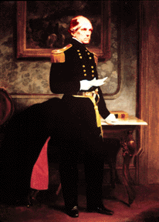
John E. Wool
June 1821 - June 1841
Appointed as inspector of infantry posts and units in 1821
Served concurrently with BG Archer and BG Croghan
Served with distinction, although he clashed with President Andrew Jackson
Saw active service in the War of 1812, Mexican War, and Civil War
Over 50 years in uniform
Notable
TIG

Slide 26
1861 ~1865
Civil War IG
Class of 1861
IGs and Assistant IGs
Lack of standard use and direction
Best use of field IG – Montgomery Meigs, Quartermaster General of the United States Army
Bottom line: Effectiveness depended on the IG and the commander

Slide 27
Post Civil War ~ 1876
War Department defined IG duties
1876: Secretary of War directed:
  The Inspector General of the Army to report to the General of the Army on all subjects pertaining to military control and discipline
  Field IGs to report directly to the unit Commanding General
Bottom line: An IG was no longer a "spy" from a higher headquarters
This relationship continues today

Slide 28
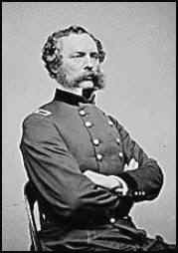
Randolph Marcy
August 1861 ~ January 1881
Notable
TIG
TIG for almost 20 years
Was Major General
George B. McClellan's father-in-law
Author of a guide book for westward-moving settlers still in print: The Prairie Traveler

Slide 29
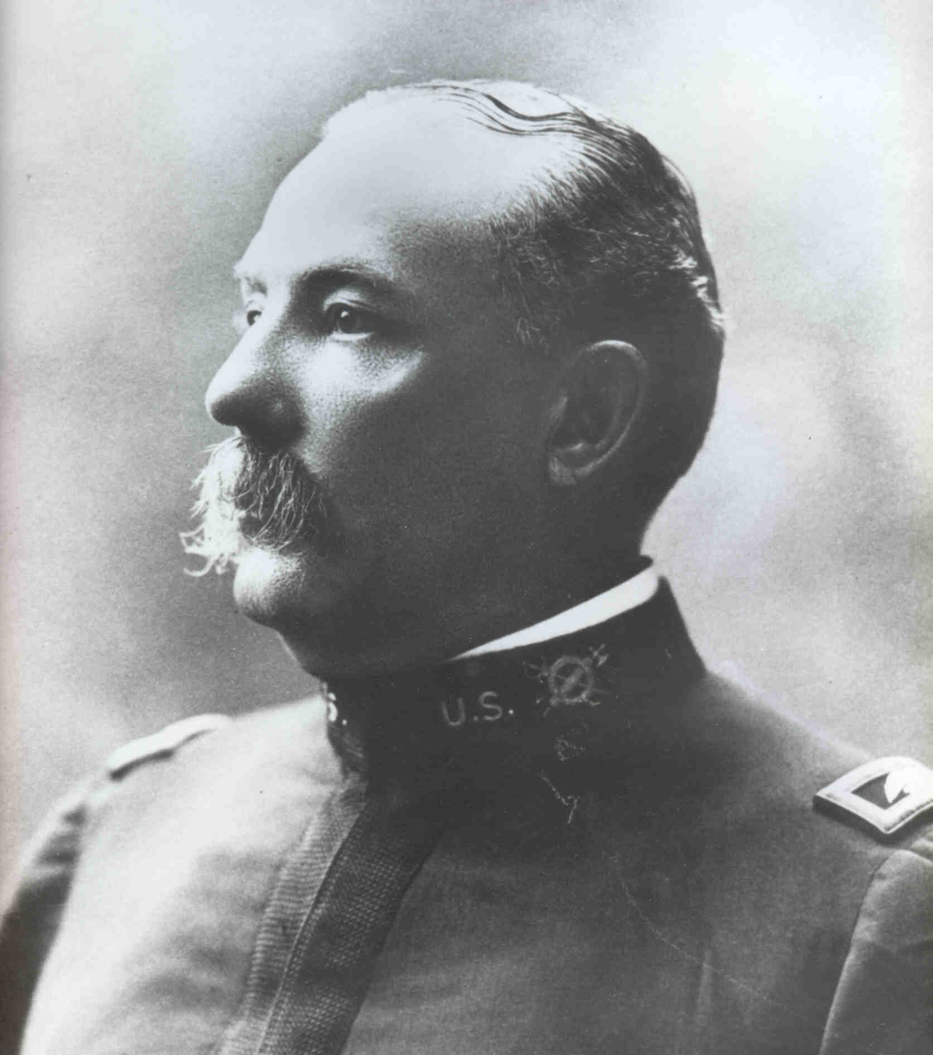
Peter D. Vroom
11 ~ 13 April 1903
TIG for only three days (promoted to BG and TIG, then retired the following day)
Joined the IG staff as a major in 1888
Notable
TIG

Slide 30
1898 ~ 1914
Inspected regiments deploying to the Philippine Insurrection – poor results
Established a systematic inspectorate in the Philippine Islands
Elihu Root (Secretary of War) Reforms – Field IG ideas sought and acted upon; focus was on training
Field inspections of units (vice garrison)

Slide 31
1914 ~ 1920
World War I
General Pershing relied heavily on his IG, MG Brewster, to address issues and concerns
  IGs in France highly centralized
  Effectiveness based on a close relationship with the American Expeditionary Force commander
79th Division IG was instrumental in addressing health and welfare issues affecting Soldiers
  Systemic inspection of support agencies
IGs addressed morale, welfare, and discipline issues in Russia
  Friction with allies, including Law of War violations

Slide 32
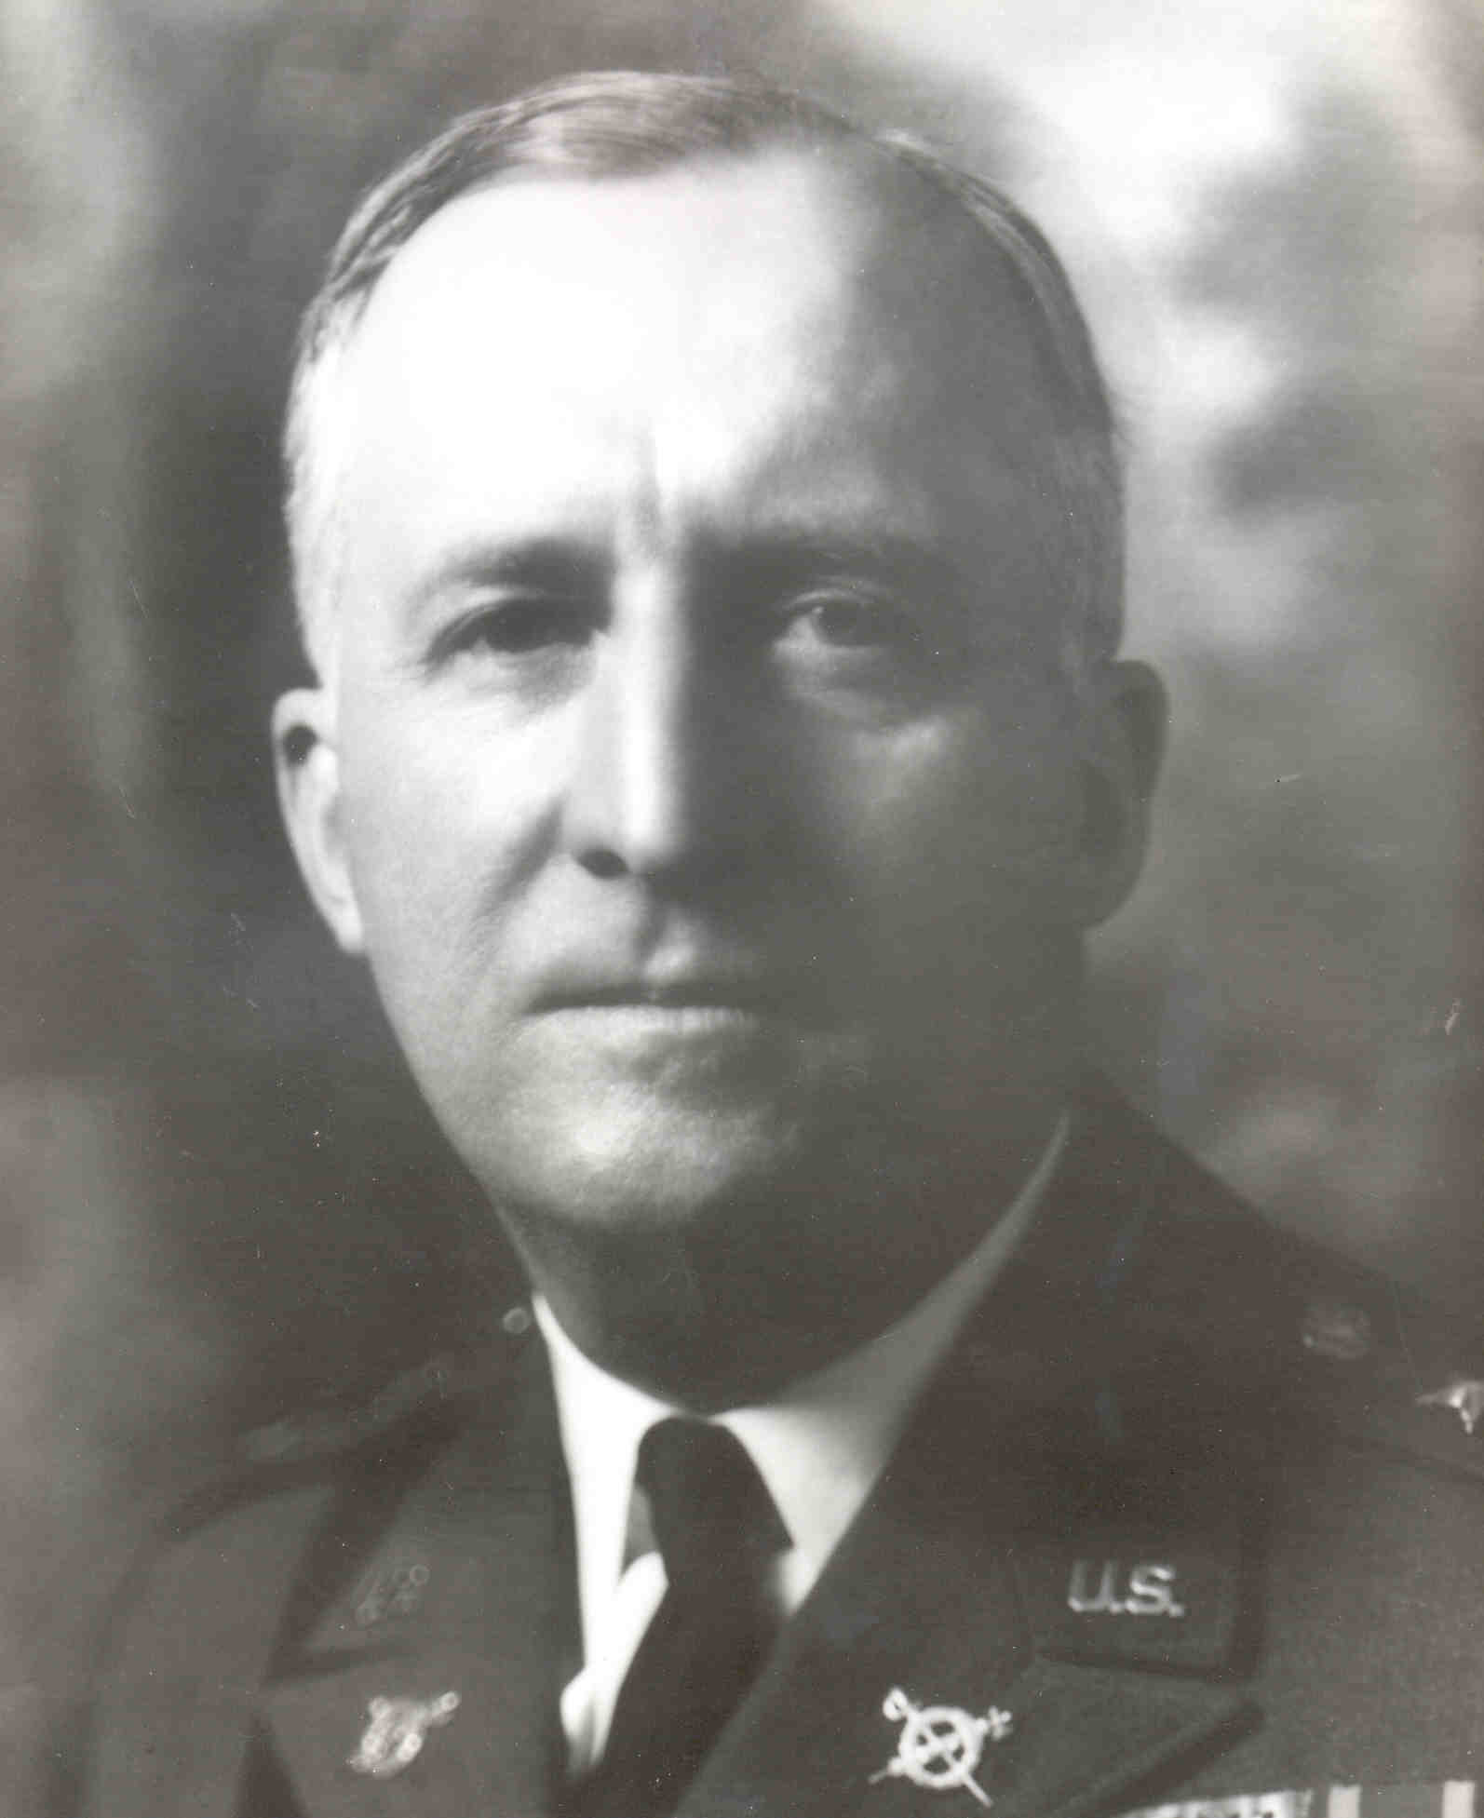
Hugh Drum
January 1930 ~ November 1931
Former Commander
of the First Army
and the
Eastern Defense
Command during
World War II
Notable
TIG

Slide 33
1940 ~ 1945
World War II
1940 ~ Commanding Generals down to division level allocated an IG under their direct control
During WWII IG mission grew in importance and scope (mobilization, inspections, investigations)
  Dachau investigation
Around 3,000 IGs around the world by 1945
Postwar ~ Assistance function emerges:
  In one year the Army demobilized from nine million to a few hundred thousand!
  Soldiers complained they weren’t being discharged quickly enough.

Slide 34
1950
Army Reorganization Act
  Inspector General's Department renamed Office of the Inspector General (OTIG)
  TIG was now:
    Responsible to Chief of Staff, Army
    Responsive to Secretary of the Army
    Charged with inquiring into and reporting upon the discipline, efficiency, and economy of the Army
    Focused on training and combat readiness

Slide 35
The Early 1950s
1952: IG training begins
  Previously, the IG Department distributed instructional material to each IG in the form of inspection and investigation guides, handbooks, and procedural material
1953: Legal case resulted in the classification of IG data as having restricted access and use

Slide 36
The Late 1950s
1956: Secretary of the Army placed technical proficiency inspections of Army atomic organizations under IG jurisdiction
1957: IG qualifications formally codified in the first AR 20-1, dated 29 January 1957:
  Highest caliber of Army officers with special qualifications:
    Mature with broad military experience
    Had not previously completed a normal three-year tour as an IG and had the moral and personal traits necessary for a position of dignity and prestige

Slide 37
The 1960s
1960: First standardized Inspector General Action Process (IGAP) published in
IG Technical Bulletin #4
1961: IG course of instruction presented to groups composed entirely of foreign officers (Republic of Korea Army officers in Seoul, Korea, and Nationalist Chinese Army Officers in Taipei, Formosa)
1969: Vietnam and the My Lai inquiry

Slide 38
Late 1970s ~ Today
Focus shifted from compliance to systemic inspection methodology
IG system became automated
1986: Goldwater-Nichols Reorganization Act reversed the IG section of the 1950 Army Reorganization Act and changed IG reporting chain
TIG became:
  Responsible to the Secretary of the Army
  Responsive to the Chief of Staff, Army
1999: The first IG SGM is appointed as TIG’s senior enlisted advisor

Slide 39
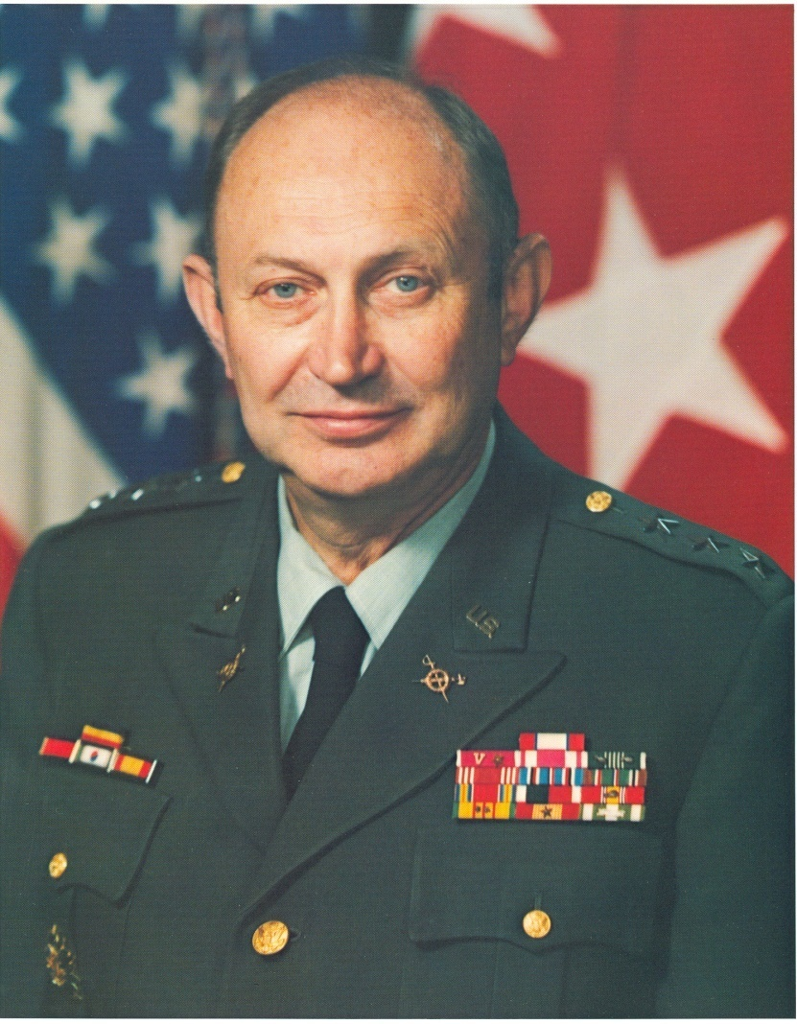
Richard G. Trefry
November 1977 ~ September 1983
Notable
TIG
Most significant TIG since von Steuben
Changed the Army IG inspections paradigm from compliance to systemic
Created TIGS in 1983 and required training for all Army IGs
Developed and instituted the Army IG oath in 1981

Slide 40
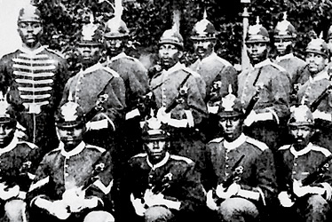
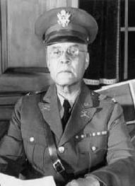
Race Relations
A Checkered History
1838 - Cherokee removal and the
“Trail of Tears”
1906 - 25th Infantry Regiment Brownsville, Texas
1918 - Special Investigation of
black officers in the 370th and 372nd Infantry Regiments
WWII - BG Benjamin O. Davis assigned as Deputy The Inspector General with a special assignment to monitor race relations in the ETO

Slide 41
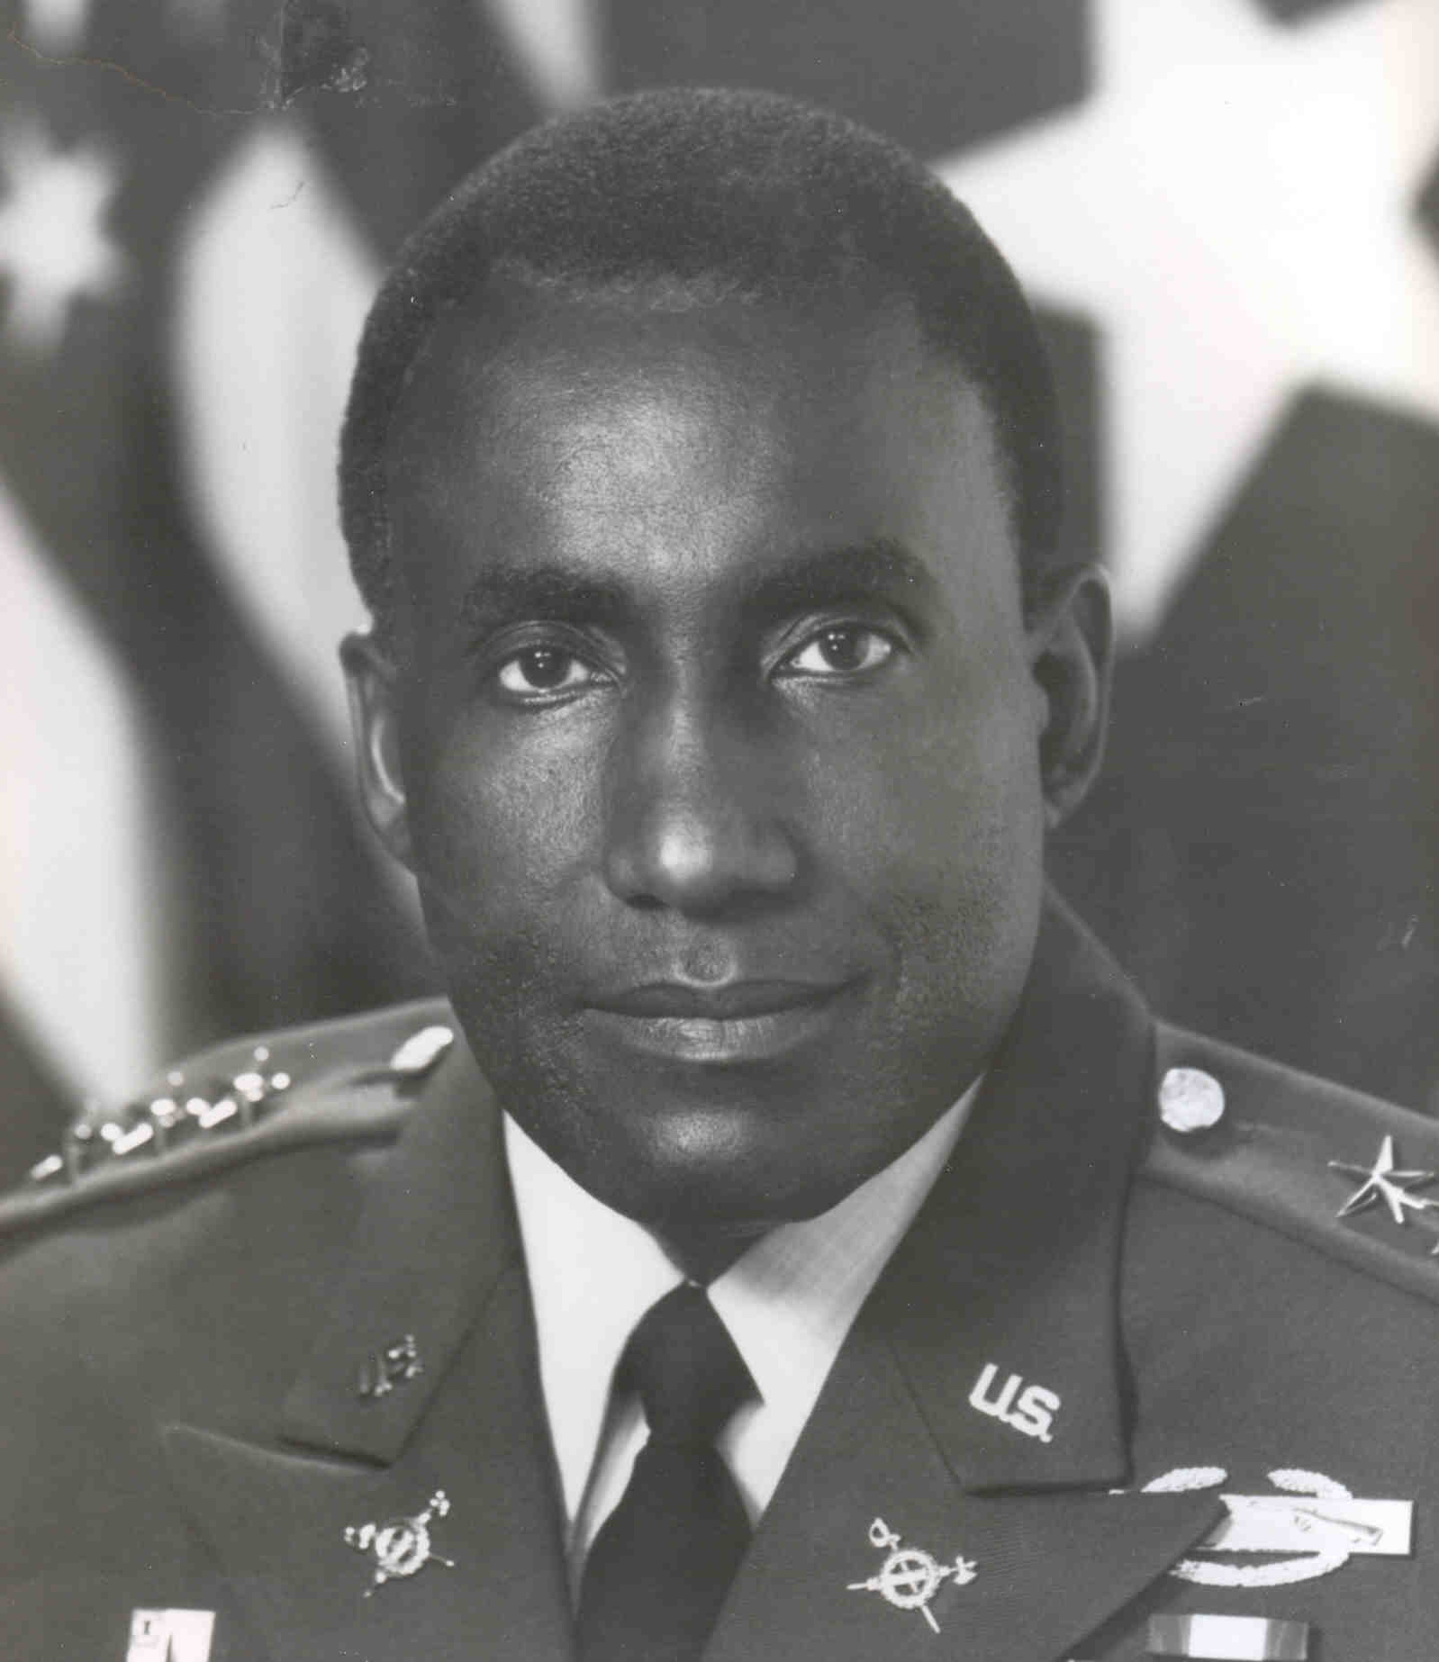
Henry Doctor, Jr.
July 1986 ~ July 1989
Notable
TIG
First African American TIG
Former Commanding General, 2nd Infantry Division, Eighth United States Army, Korea

Slide 42
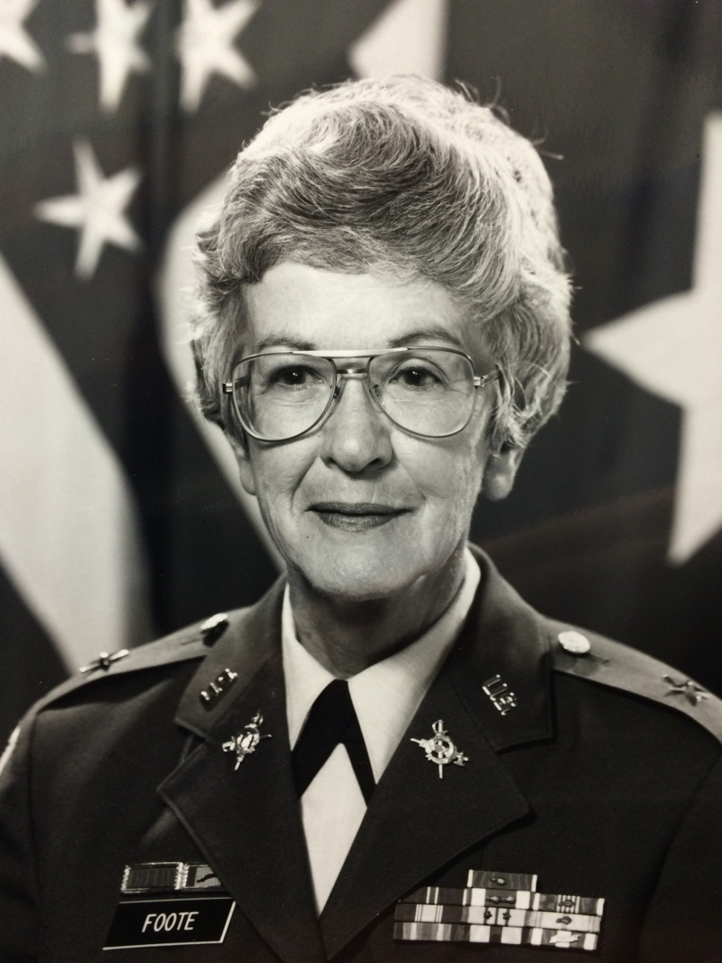
Evelyn “Pat” Foote
June 1986 ~ July 1988
Notable
DTIG
First female DTIG
First female commander of Fort Belvoir (1988–1989)
Joined the Army in 1960 as part of the Women’s Army Corps (WAC)
Retired as a Brigadier General in September 1989

Slide 43
Today’s IG System
Inspections
Assistance
Investigations
Teaching and Training

Slide 44
The von Steuben Model
Our Guiding Philosophy
ELO
3
From the beginning,
Inspectors General have
been responsible for
assisting commanders
with improving readiness and warfighting capability!
Teach and Train
The IG Reference Guide, pages 1-5 and 1-6

Slide 45
Historical Constants
Inspectors General:
  Assist commanders in checking upon and instilling discipline, ethics, and standards
  Provide quick response for the commander’s special interests
  Represent readily available assets for the commander for critical but unanticipated missions
  Are often a substitute for a lack of experience

Slide 46
IG Crest
ELO
4
Military power and justice
Civil authority
Sword
Fasces
Right
Forward
and
Wreath
IG Reference Guide, page 1-27
Academic and intellectual
achievement
“First be correct – then take action”

Slide 47
Summary
Describe the origins of the IG system?
Describe the reasons why was von Steuben the first effective IG?
Describe the von Steuben model and why IGs adhere to that model today?
Describe the meaning of the IG Crest?

Slide 48
History of the U.S. Army
Inspector General System

