Slide 1



The Army Components
The Army Components’
Inspectors General

Slide 2
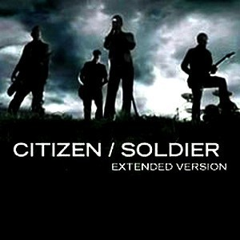
Why Cover the Components? We are One Army
The Army Components’
Inspectors General
To provide all prospective Inspector General students -- Active Component, National Guard, and U.S. Army Reserve Soldiers; members of other Armed Services; and Department of the Army Civilians (DAC) -- with a fundamental understanding of the uniqueness of the various Army Components within the context of the Army IG system.

Slide 3
References
The Army Components’
Inspectors General
The Army Components’ Inspectors General (Part 6, The IG Reference Guide)
Profile of the Army
AR 20-1, Inspector General Activities and Procedures, Chapter 1

Slide 4
Enabling Learning Objectives
The Army Components’
Inspectors General
ELO
Describe the overall command-and-control system of the Army, specifically the Army National Guard and the Army Reserve.
Describe the requirements and duties of the U.S. Property and Fiscal Officer (USPFO).
Describe the various Full-Time Support (FTS) programs used within the Army National Guard and the Army Reserve.

Slide 5
Enabling Learning Objectives
(continued)
The Army Components’
Inspectors General
Describe the various duty and corresponding pay statuses.
Describe the Incapacitation Pay Program and common problem areas and areas of concern.
Describe the types of mobilization.
Describe the phases of mobilization.

Slide 6
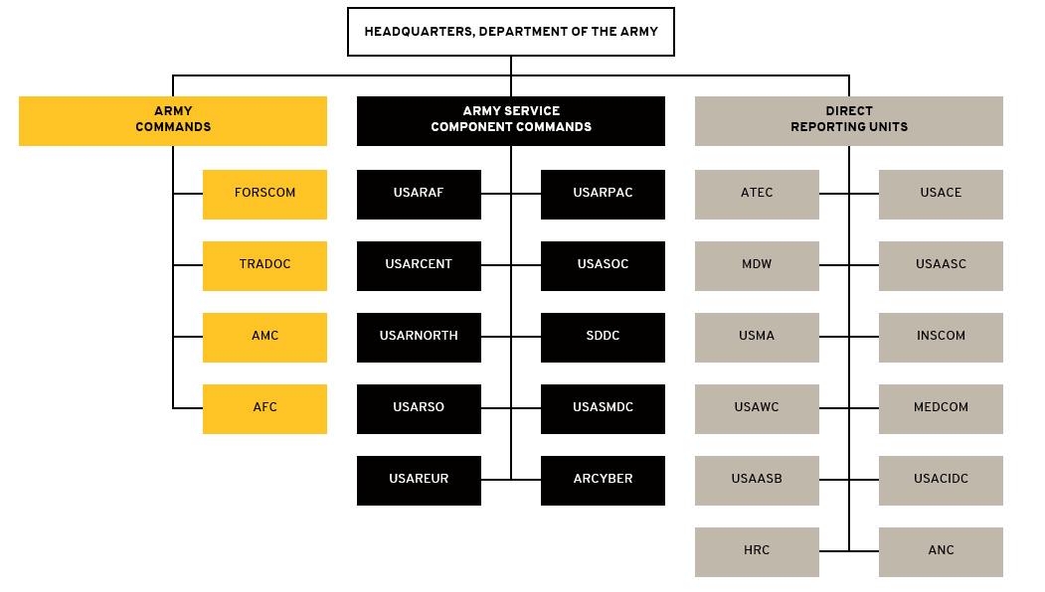
Army Command Structure
ELO
1
The Army Components’
Inspectors General
IG Reference Guide, Part 6

Slide 7

Army / ARNG / USAR
References
The Army Components’
Inspectors General
USC Title 10
USC Title 32
AR 135 Series (ARNG and USAR: FTS, AGR, promotions, etc…)
AR 140 Series (USAR: FTS, AGR, etc…)
NGRs
USARC Regulations
AR 600-20, Army Command Policy
AR 525-29 Army Force Generation
AR 71-32, Force Development
NGR 600-100

Slide 8
Army Force Structure (1,015,000)
The Army Components’
Inspectors General
49% of the Generating Forces are in the two Reserve Components
60% of the Operating Forces are in the two Reserve Components
65% of the Inspectors General are in the Active Component

Slide 9
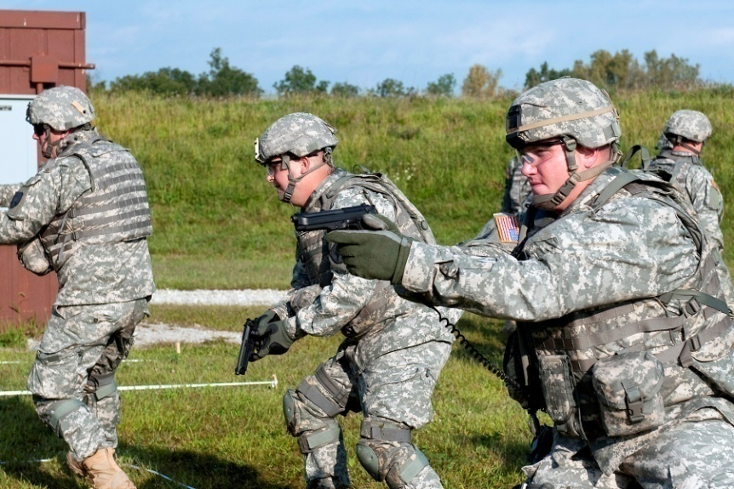
Just a Few Army Acronyms
The Army Components’
Inspectors General
RC - Reserve Component(s)
IRR - Individual Ready Reserves
IMA - Individual Mobilization Augmentation
TPU - Troop Program Unit
IDT - Inactive-Duty Training
M-Day - Mobilization-Day Soldier
FTS - Full-Time Support
PPP - Power-Projection Platform

Slide 10
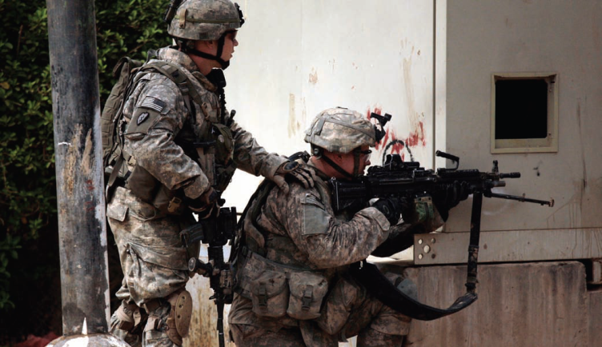
Just a Few Army Acronyms (continued)
The Army Components’
Inspectors General
MCU - Multiple-Component Unit
ACOM - Army Command
ASCC - Army Service Component Command
DRU - Direct Reporting Unit
DARNG - Director, Army National Guard
CNGB - Chief, National Guard Bureau
CAR - Chief, Army Reserve

Slide 11
The Army
The Army Components’
Inspectors General
COMPO 1 = Active Component
COMPO 2 = Army National Guard
COMPO 3 = Army Reserve
MULTI-COMPO = Active Component, Army National Guard, and Army Reserve (2 or more)

Slide 12
Multi-Component
The Army Components’
Inspectors General
+
COMPO 1
COMPO 2
+
Multi-Component
COMPO 3
A unit, on a single document, that is authorized personnel and / or equipment from more than one component.

Slide 13
Active Army
The Army Components’
Inspectors General
COMPO 1

Slide 14
Legal Basis for
Active Component
The Army Components’
Inspectors General
Title 10, United States Code, Section 3075
“The regular Army is the component of the Army that consists of persons whose continuous service on active duty in both peace and war is contemplated by law, and of retired members of the Regular Army.”

Slide 15
Active Component -
Mission
The Army Components’
Inspectors General
The U.S. Army’s mission is to fight and win our Nation’s wars by providing prompt, sustained land dominance across the full range of military operations and spectrum of conflict in support of combatant commanders.
www.army.mil/info/organization/

Slide 16
United States
Army National Guard
The Army Components’
Inspectors General
COMPO 2

Slide 17
Legal Basis for
Army National Guard
The Army Components’
Inspectors General
Title 32, United States Code, Section 10107
“In accordance with the traditional military policy of the United States, it is essential that the strength and organization of the Army National Guard and the Air National Guard as an integral part of the first line defenses of the United States be maintained and assured at all times.”

Slide 18
Army National Guard - Mission
The Army Components’
Inspectors General
The Army National Guard, a community-based Operational Force that serves as the primary Combat Reserve of the Army, provides ready units to support global and domestic requirements.
Army National Guard 2014-2020 Strategic Planning Guidance

Slide 19
Dual Missions for
National Guard
The Army Components’
Inspectors General
Federal: To maintain combat-ready units and trained personnel available to mobilize and deploy in support of the National Military Strategy.
State: To function efficiently for the protection of life and property and to preserve peace, order, and public safety under State authorities.

Slide 20
ELO
1
Federal
Title 10
The Army Components’
Inspectors General
President
State
Title 32
Secretary of Defense
Combatant
Commanders
Chairman,
Joint Chiefs of Staff
Governor
Secretary
of the Air Force
Chief, National
Guard Bureau
Secretary
of the Army
The Adjutant General
Director,
Air National Guard
Director,
Army National Guard
Army National Guard
Units
Air National Guard
Units
IG Reference Guide, Part 6

Slide 21
National Guard Key Personnel at the State
The Army Components’
Inspectors General
Chief, National Guard Bureau (CNGB)
Governor
The Adjutant General (TAG) (Army or Air NG)
Senior Army Advisor, Army National Guard (SRAAG)
United States Property & Fiscal Officer (USPFO)

Slide 22
USPFO Roles and Responsibilities
ELO
2
The Army Components’
Inspectors General
Commissioned ARNG or ANG Officer on Title 10 status
The Adjutant General (TAG) recommends, the Governor nominates, and the CNGB appoints
Work for and responsible to CNGB with duty in a state
Provides technical assistance and advice to TAG on the proper use of Federal funds
Controls and oversees all Federal funds and property of the U.S. Government issued to the State
First Army IG inspects USPFOs on behalf of FORSCOM
ARNG Regulation 130-6, United States Property and Fiscal Officer, Appointment, Duties and Responsibilities

Slide 23
United States Army Reserve
The Army Components’
Inspectors General
COMPO 3

Slide 24
Legal Basis for
Army Reserve
The Army Components’
Inspectors General
Title 10, United States Code, Section 10104
“To provide trained units and qualified persons available for active duty in the armed forces, in time of war or national emergency and at such other times as the national security requires, to fill the needs of the armed forces whenever, during, and after the period needed to procure and train additional units and qualified persons to achieve the planned mobilization, more units and persons are needed than are in the regular components.”

Slide 25
Army Reserve - Mission
The Army Components’
Inspectors General
The Army Reserve provides trained, equipped, and ready Soldiers and cohesive units to meet global requirements across the full spectrum of operations.
Army Reserve 2020 Vision and Strategy

Slide 26
Army Reserve
Command and Control
ELO
1
The Army Components’
Inspectors General
HQDA
FORSCOM
USARC
GEOGRAPHIC CMDS
FUNCTIONAL CMDS
IG Reference Guide, Part 6 and www.usar.army.mil/Commands/

Slide 27
Reserve Categories
Total Reserve
Manpower
The Army Components’
Inspectors General
Standby
Reserve
Ready
Reserve
Retired
Reserve

Slide 28
Standby Reserve
The Army Components’
Inspectors General
ARNG and USAR SM (normally senior)
Fully Trained (MOSQ)
Involuntarily mobilized
Key Civilian Employees
Temporary hardship or disability
Do not train and are not in units
Full Mobilization in time of war

Slide 29
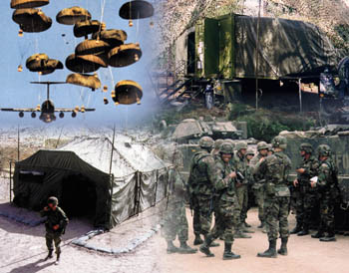
Ready Reserve
The Army Components’
Inspectors General
Ready Reserve
Individual
Ready Reserve
Inactive
National Guard
Selected
Reserve
Partial Mobilization

Slide 30
Ready Reserve
The Army Components’
Inspectors General
Ready Reserve
Individual
Ready Reserve
Inactive
National Guard
Selected
Reserve
Partial Mobilization

Slide 31
Ready Reserve
Individual Ready Reserve (IRR)
The Army Components’
Inspectors General
Managed by HRC, Fort Knox
Soldiers have served in AC or selected reserves
Fully or partially trained (MOSQ)
May not have completed service obligation (eight years)
Can obtain retirement points
Partial Mobilization (up to 1 million, 24 months)

Slide 32
Ready Reserve
The Army Components’
Inspectors General
Ready Reserve
Individual
Ready Reserve
Inactive
National Guard
Selected
Reserve
Partial Mobilization

Slide 33
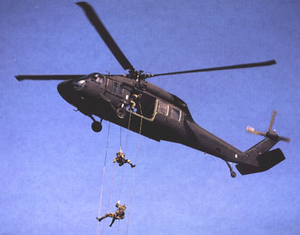
Ready Reserve
Inactive Army National Guard
The Army Components’
Inspectors General
  ARNG only
  Non-participating unit members
  Records maintained by State
  Yearly muster required
  Partial Mobilization (involuntary)

Slide 34
Ready Reserve
The Army Components’
Inspectors General
Ready Reserve
Individual
Ready Reserve
Inactive
National Guard
Selected
Reserve
Partial Mobilization

Slide 35
Ready Reserve
Selected Reserve
The Army Components’
Inspectors General
Selected Reserve
Trained
Personnel
Units
Army National Guard Units: M-Day, Drilling Guardsman, 15-Day Annual Training
Army Reserve Units: Troop Program Units, Battle Assembly, TPU-Soldier, 14-Day Annual Training

Slide 36
Retired Reserve
The Army Components’
Inspectors General
Three Types of Retirees
AC = Records transferred to Fort Knox
RC = Under age 60: “Gray Area”
RC = Over age 60: available to receive pay / benefits
Involuntary recall to active duty

Slide 37
RC Full-Time Support
(FTS)
ELO
3
The Army Components’
Inspectors General
Active Guard / Reserve (AGR)
Military Technician (MILTECH)
Department of Army Civilian (DAC)
Active Component (AC)
IG Reference Guide, Part 6

Slide 38
Full-Time Support
(continued)
The Army Components’
Inspectors General
Active Guard / Reserve (AGR)
ARNG, Title 10 or 32
USAR, Title 10
Purpose is to support readiness of M-Day and TPU units
Military Technician (MILTECH)
Dual-Status Personnel (Required)
ARNG - Wears uniform during week
USAR - Wears civilian clothes during week

Slide 39
Full-Time Support
(continued)
The Army Components’
Inspectors General
Department of Army Civilian (DAC)
Civilian employees not requiring dual status in unit
Active Component (AC)
Unit: First Army and Training Support Divisions
  Training, Readiness, Mobilization, Deployment
Individual: AC NCOs, COLs / LTCs
Command / Leadership Exchange Program

Slide 40
    Compensation
ELO
4
The Army Components’
Inspectors General
AC (Title 10) - Paid every day of the month
AGR USAR (Title 10) - Paid every day of the month
AGR ARNG (Title 10 & Title 32) - Paid every day of the month
IG Reference Guide, Part 6

Slide 41
    Compensation
    (continued)
The Army Components’
Inspectors General
Army Reserve Unit USAR (Title 10) - Paid for battle assemblies (IDT) and annual training (AT)
Mobilization-Day (M-Day) ARNG (Title 32) - Paid for drill weekend duty (IDT) and annual training (AT)

Slide 42
    Compensation
    (continued)
The Army Components’
Inspectors General
USAR and ARNG (Reserve Income Replacement Program) – Paid to eligible Soldiers on Active Duty in an involuntary status
  Soldiers are paid the difference between their civilian salary and their total military compensation
  To be eligible, Soldiers must have completed 18 consecutive months of active duty, or
  Completed 24 months of active duty during the previous 60 months, or
  Been involuntarily mobilized for 180 days or more within six months of the previous involuntary period of active duty of more than 180 days
  Income replacement payments will be made only for full months of qualifying involuntary active duty performed from August 2006 through December 2013 (USC 37, Chapter 17)

Slide 43
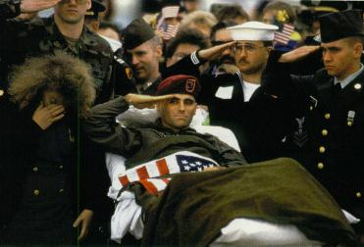
    Incapacitation Pay
ELO
5
Pay for injured / sick RC Soldiers resulting from Official Duty
The Army Components’
Inspectors General
Injury must result in loss of income to service member
Line of Duty determination must be “Yes” (AR 600-8-4)
Individual must re-submit claim monthly (DA Form 7574)
Three-month review by AC Doctor (DA Form 7574-1)
Potential for FRAUD
AR 135-381, Incapacitation of RC Soldiers
IG Reference Guide, Part 6

Slide 44
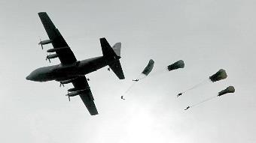
Mobilization
The Army Components’
Inspectors General

Slide 45
Types of Mobilization
ELO
6
Congress
President
Secretary of Defense
Service Secretary
No personnel limitation
Duration plus 6 months; Involuntary
Congressional Declaration of War or National Emergency
The Army Components’
Inspectors General
FULL
MOBILIZATION
10 USC 12301 (a)
PARTIAL
MOBILIZATION *
10 USC 12302
Maximum 1M; Requires POTUS
Declaration of National Emergency
24 consecutive months; Involuntary
For officially named operations
PRESIDENTIAL RESERVE CALL UP
10 USC 12304 **
Maximum 200K Ready Reserve & 30K IRR
365 days; Involuntary
Requires Executive Order
RESERVE EMERGENCY CALL UP
10 USC 12304a *
No personnel limitation
120 days; Involuntary
No National Guard
RESERVE PRE-PLANNED CALL UP ISO COCOMs
10 USC 12304b *
Maximum 60K
365 days; Involuntary
Mission / costs in Defense Budget
Annual Training / Operational
Mission; Involuntary
Governor’s consent
15 DAY-STATUTE *
10 USC 12301 (b)
Voluntary
Limited to 3 years AD out of 4
Governor’s consent
Can be used for operational
missions or service support
ACTIVE DUTY FOR OPERATIONAL SUPPORT *
10 USC 12301 (d)
Mobilization authorities currently used or available for use(*)
12304 requires specific POTUS approval prior to utilization (**)
All Services access RC utilizing these authorities in conjunction with DoD policies
Access incomplete without associated funding allocated to Services to manage
Access = Authority + Funding
IG Reference Guide, Part 6

Slide 46
Five Phases of Mobilization
ELO
7
The Army Components’
Inspectors General
Phase I Planning
Phase II Alert
Phase III Home station
Phase IV Power Projection Platform
Phase V Port of Embarkation
IG Reference Guide, Part 6

Slide 47
Mobilization
The Force Projection Process
MOBILIZATION
POWER
PROJ
PLAT
DEPLOY
Phase I
Post-Mobilization Training

Slide 48
Reserve Component Issues
The Army Components’
Inspectors General
Issue
Who to contact for help
Pay
Promotions
Medical
Multiple Deployments
Professional Schools
Local Fin, RD IG, State IG; Civilian Pay: Customer Service Rep first, then higher
RD/USARC IG, State/NGB IG
PPP Installation IG
FORSCOM IG
RD IG, USARC IG, NGB IG
ARNG Pay Ombudsman toll-free 1-877-ARNGPAY
or by email at ARNG-MILPAY@ARNG-FSC.NGB.ARMY.MIL
USAR Pay Inquiry Hotline toll-free 1-877-462-7782
Civilian Pay Helpdesk (Indianapolis) toll-free 1-800-538-9043

Slide 49
Summary
The Army Components’
Inspectors General
Command and Control (C2)
USPFO
Full-Time Support
Duty Status and Pay
Incapacitation Pay
Types of Mobilization
Phases of Mobilization

Slide 50
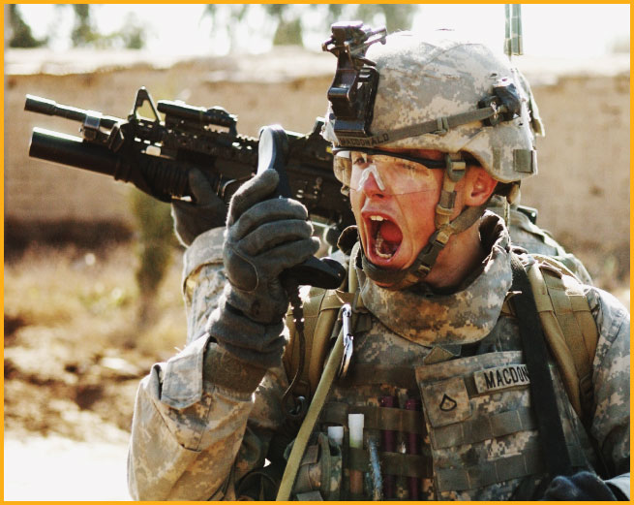

Questions?
The Army Components’
Inspectors General

