Slide 1
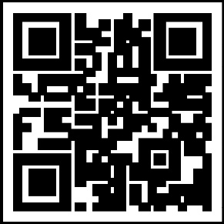
THE
IG Update
Volume 24-1, November 2023
Major revisions to AR 1-201 and the Organizational Inspection Program
On 1 November 2023, the Department of the Army IG published a major revision to Army Regulation 1-201, Army Inspections Policy. The updated regulation is effective 1 December 2023.
Notably, the revised AR 1-201 has major implications for the Organizational Inspection Program, or OIP, which is an inspectable and mandatory program for all battalion-level and higher commands throughout all components of the Army.
At the battalion and brigade level, OIP will be managed by the executive officer or second in command.
At division and higher echelons, OIP is usually run by the chief of staff or operations officer.
Inspectors general are expressly prohibited from managing an OIP, but they can provide guidance and expertise.
(Note: The next revision of AR 20-1 will prohibit the use of Inspectors General as coordinators for the command’s Organizational Inspection Program.)
AR 1-201 also restores Subsequent Command Inspections (SCI), which are the follow-up to Initial Command Inspections (ICI), conducted shortly after an officer takes command of a unit. SCIs were eliminated in 2018.
The primary purpose of the Subsequent Command Inspection is to follow up and ensure issues noted during the ICI have been corrected. If deficiencies found during the ICI are determined to be minor, the requirement to conduct the SCI may be waived by the first general officer in the chain of command.
As a reminder to all unit commanders, staff members, and OIP coordinators, inspections are never meant to be punitive. ICIs and SCIs are not just tools used to gauge readiness levels, but they can also be used to teach and train commanders about what right looks like.
For more information on Army Inspections and the Organizational Inspection Program, go to the Army IG website at ig.army.mil – and also talk to your local IG.
Unit patch/logo
goes here
Your Unit Name
Commanding General
MG Soldier Q. Public
Command Sergeant Major
CSM Soldier Q. Public
Command Inspector General
LTC Soldier Q. Public
Inspector General NCOIC
SGM Soldier Q. Public
IG Points of Contact
Unit IG Office
Building 1234
Hooah Drive
Fort Swampy XX 55555
Pertinent Regulations/Policies:
AR 1-201: Army Inspection Policy, 1 November 2023
AR 20-1: Inspector General Activities and Procedures, 23 March 2020
The OIP Guide for Commanders, October 2023
The Inspections Guide, October 2023
All are available at ig.army.mil
IG.army.mil

